Slide 1

Margie Beavis
Thanks Jim Green
Notes:
Nuclear chain- reactors and weapon
Climate impacts – more forced displacements, refugees, conflicts

Slide 2
Nuclear reactor risks
Accidents, warfare and the military industrial complex.
What could possibly go wrong?

Slide 3
Accidents and attacks
No commercial insurance
For catastrophic reactor accidents
For households
Why?

Slide 4
Accidents
Complex systems fail at some point
Nuclear reactors have the potential for radioactive releases that are enormous in size and last for years.
Best known: Windscale, Chernobyl, Three Mile Island and Fukushima
There have been at least fifteen accidents involving fuel or reactor core damage, with substantial risk of uncontrolled radioactive release, in Canada, Germany, Japan, Slovakia, the United Kingdom, Ukraine and the United States.
Combined Environment Groups Submission to the Senate Environment and Communications Legislation, Committee Inquiry into the Environment and Other Legislation Amendment (Removing Nuclear Energy Prohibitions) Bill 2022. Page 83 https://nuclear.foe.org.au/wp-content/uploads/Combined-Environmental-NGOs-submission.pdf

Slide 5
So how often do accidents happen?
2017 analysis of 216 events between 1950 and 2014 that threated safety or damaged human health or property.
Suggested:
One event per year worldwide
50% chance of a Fukushima magnitude (or greater) event happening within 62 years
Wheatley S, Sovacool B, Sornette D. Of Disasters and Dragon Kings: A Statistical Analysis of Nuclear Power Incidents and Accidents. Risk Analysis. January 2017;37(1):99-115. https://doi.org/10.1111/risa.12587

Slide 6
Nuclear reactor core meltdown/INES 4 accidents
(INES 4 = high probability of significant public exposure)
Total of 20+ including Fukushima Daiichi 1-3
13 power reactors, multiple types
All now permanently shut down
Core melt accidents: 1 in 1300 reactor years
Many near-misses
    Burns, Ewing and Navrotsky, Science, 2012
    Brice Smith, Insurmountable risks IEER 2006
    Thomas Cochran, NRDC US Senate testimony 12.4.11

Slide 7
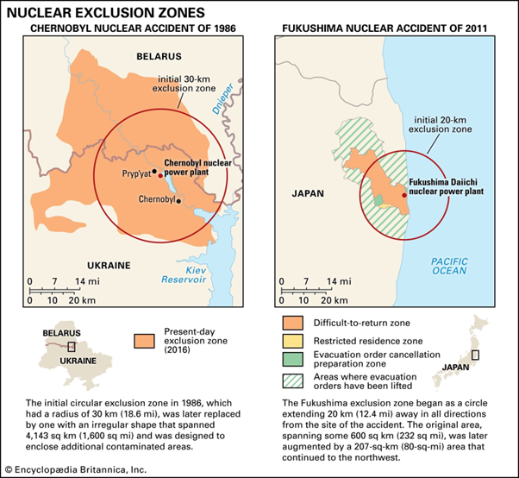
Encyclopedia Britannica
Notes:
Following the meltdowns, fires and explosions that destroyed four of the reactors at Fukushima, there was a mandatory evacuation zone out to 20 kms, and out to 30 kms evacuation was either required or ‘suggested’. The mandatory evacuation zone covered 807 sq kms, resulting in the evacuation of 191,000 people. After the 1986 Chernobyl disaster in Ukraine, an initial 30 km evacuation zone was replaced by a larger evacuation zone covering 4,143 sq kms and 350,000 people were evacuated.

Slide 8
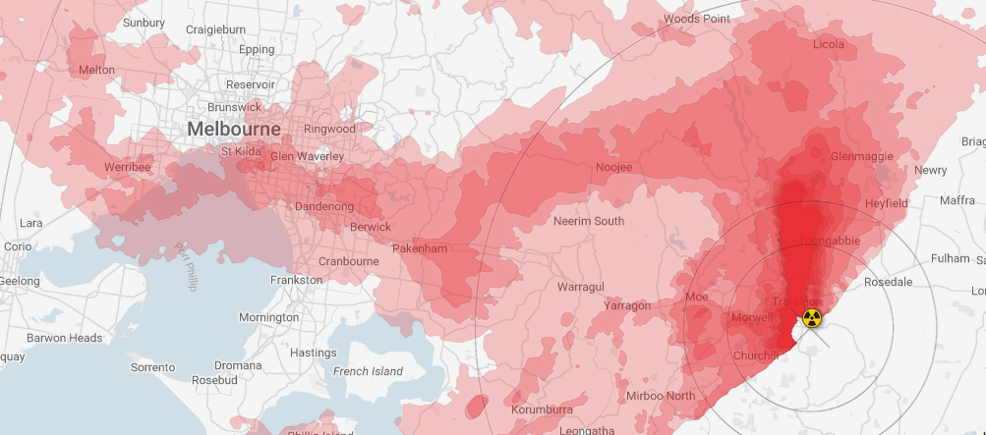
Accident Fall Out
Loy Yang with a southerly wind nuclearplume.au

Slide 9
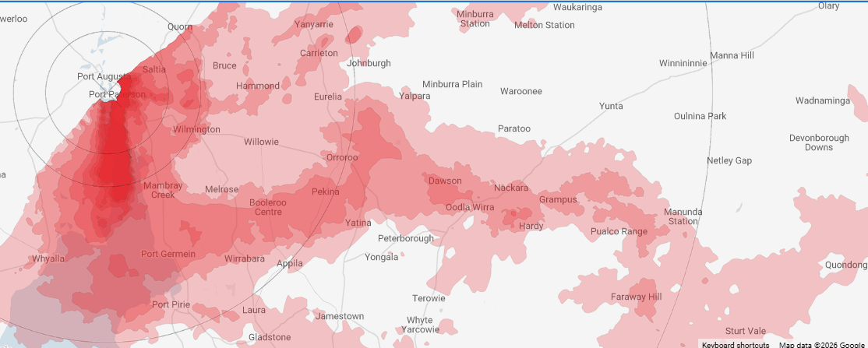
Accident Fall Out
Post Augusta with a northerly wind nuclearplume.au

Slide 10
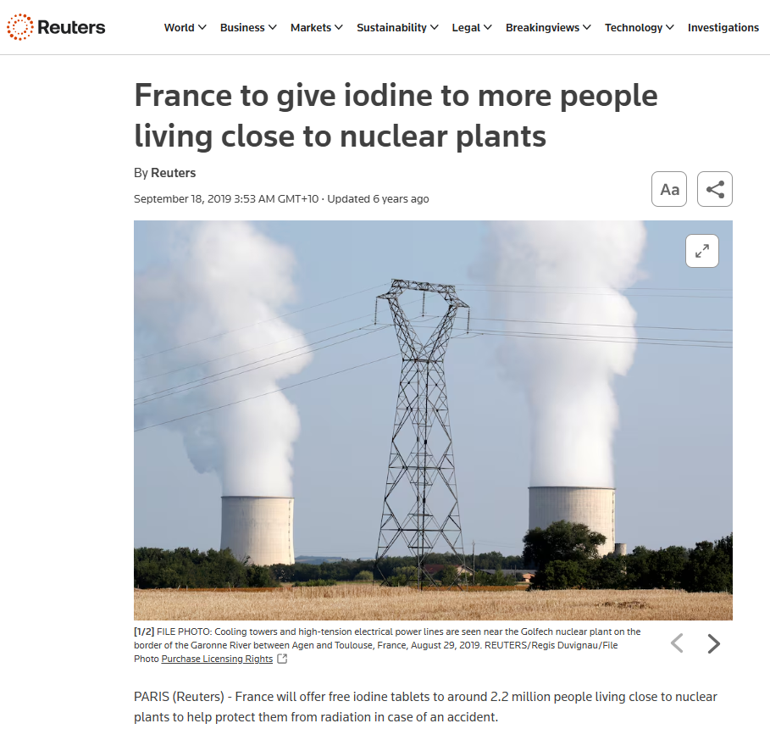
SA towns within 30 kms of Northern Power Station (closed):
Port Augusta,
Blanche Harbor,
Douglas Point,
Quorn,
Miranda.

Slide 11
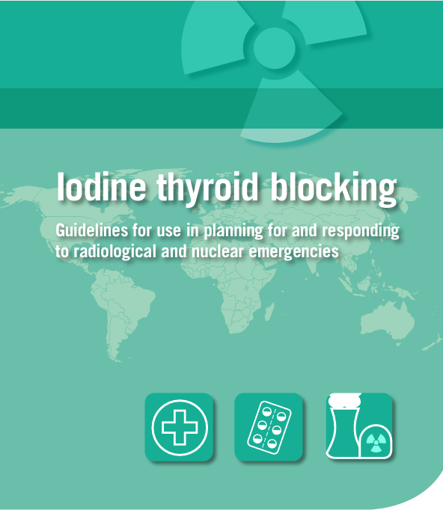

Will surrounding areas be given Iodine tablets?
How will everyone be notified?
Will you know about an accident - in time?

Slide 12
Reactors are vulnerable to climate change risks
Shut-downs with heatwaves, droughts
Fires
Floods
“In the last decade (2010-2019), the frequency of climate-related nuclear plant outages was already nearly eight times higher than in the 1990s”
Beware statements that “new reactors are safer”
That’s what they always say about new reactors… and not true.
Not proven until decades of operation.
Nuclear is not the solution: the folly of atomic power in the age of climate change, by M. V. Ramana, London, Verso, 2024,

Slide 13
Misleading claims
Repeated claims linking radiology, radiotherapy and nuclear medicine to nuclear power:
“Nuclear energy already plays a major role in medicine and healthcare, diagnosing and treating thousands of Australians every day”.
Nuclear medicine has nothing to do with getting nuclear power
Notes:
The Coalition has also made claims linking radiology, radiotherapy and nuclear medicine to nuclear power that are patently false and deliberately misleading.
A letter sent by Coalition MPs to their constituents earlier this year claimed that: “Nuclear energy already plays a major role in medicine and healthcare, diagnosing and treating thousands of Australians every day”.
We do not have, and have never had, nuclear power in Australia, and the nuclear power proposal has no connection to our world class nuclear medicine, radiology or radiotherapy services.

Slide 14
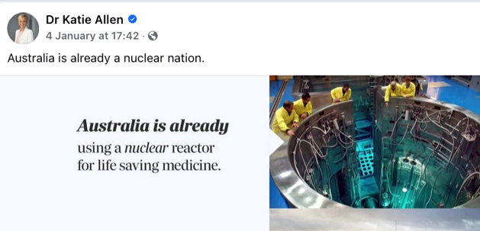
False claims about nuclear power

Slide 15
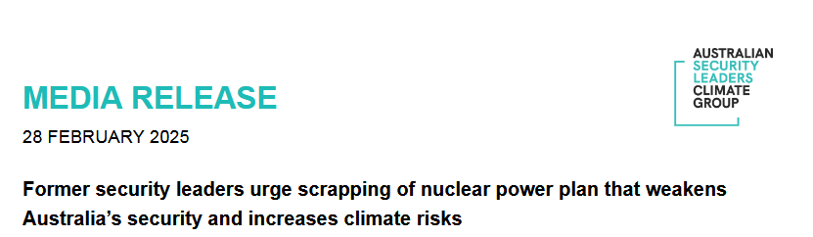
Attacks
The Australian Security Leaders Climate Group
“Australia should not proceed with the proposed plan for nuclear power stations due to the climate and security consequences they pose to the nation”

Slide 16
Admiral Chris Barrie- former head of Australian Defence Force
Every nuclear power facility is a potential dirty bomb because rupture of the containment facilities can cause devastating damage.”
“Modern warfare is increasingly focused on missiles and uncrewed arial systems (drones) and with the proposed power stations all located within 100 km of the coast, they are a clear and accessible target.”
Prolong coal and gas “Derail our climate targets”

Slide 17
Vulnerable in peace as well
1983- 2007 There were 10 security incidents regarding Lucas Heights
With more sophisticated technologies, attacks by terrorists or criminals get easier, with AI, cyberattack, missiles and drones.

Slide 18
Nuclear Waste
Nobody wants this highly toxic stuff
Needs isolation for 10,000- 100,000 years
(Pharaohs were only 5,000 years ago)
Potential for health impacts for many many future generations
Divides communities – major and lasting social and mental health issues
First Nations communities repeatedly targeted.
Weapons testing a national disgrace.

Slide 19
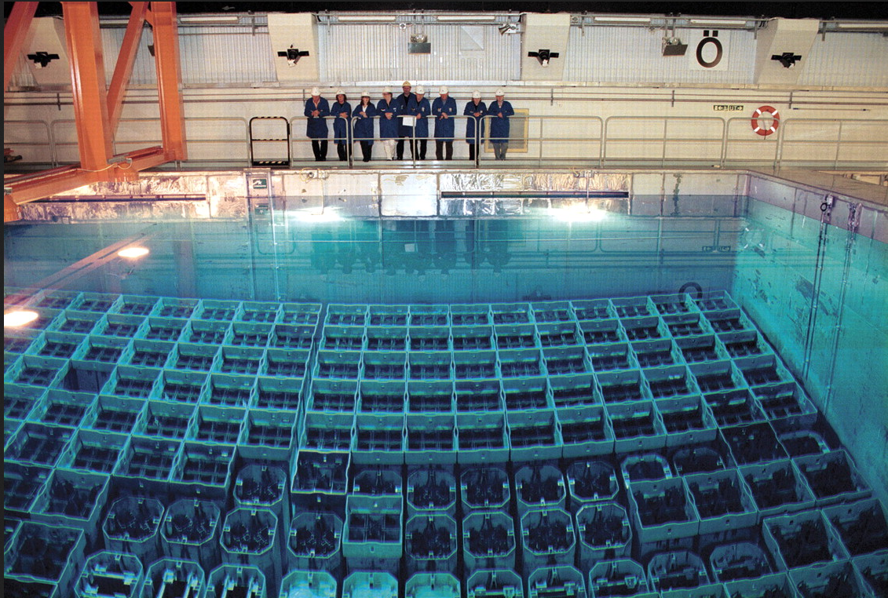
Spent fuel cooling pool- on site of reactor

Slide 20
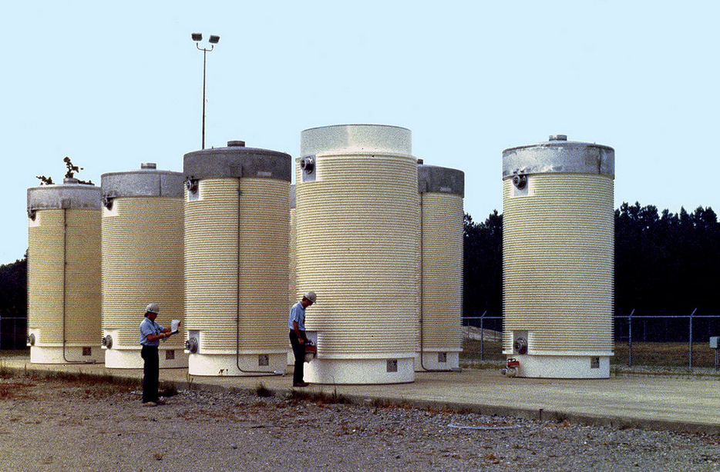
Canisters- usually also on site of reactor

Slide 21
Russian-held Zaporizhzhia Nuclear Power Plant (ZNPP).
Captured March 4th 2022 All six reactors shut down
Since then:
Multiple drone strikes – each side accuses the other
Military action has cut off site power at last nine times (IAEA)
Since Russian forces destroyed the Kakhovka Reservoir dam in 2023, replacement groundwater wells supply cooling water
https://www.congress.gov/crs-product/IN11883
https://www.securitycouncilreport.org/whatsinblue/2026/07/ukraine-briefing-36.php
https://en.wikipedia.org/wiki/Zaporizhzhia_Nuclear_Power_Plant_crisis#2025
Notes:
Whenever offsite power is lost, the plant's emergency diesel generators are activated to provide electricity for reactor cooling systems.

Slide 22
Ongoing threats
Direct damage to reactors
Military damage to reactor safety systems
Station blackout: loss of electric power
Disruption of plant personnel
Damage to spent fuel pool or cooling systems
https://www.congress.gov/crs-product/IN11883
Notes:
On 4 October 2024, the Ukrainian Main Directorate of Intelligence assassinated the head of security at ZNPP
On 10 December 2024 an IAEA vehicle was hit by a Russian drone while driving IAEA observers
On 15 July 2026 , Moscow accused Ukraine of carrying out a drone strike that killed the chief engineer

Slide 23
Weapons proliferation
PM John Gorton thought nuclear power could enable Australia to get weapons later
Enormous cost raises questions from our neighbours and potentially starts a “race”
Climate change worse
Increased forced displacements
Increased conflicts
Notes:
“Arms race” Indeed Prime Minister John Gorton admitted “We were interested in this thing because it could provide electricity to everybody and it could, if you decided later on, it could make an atomic bomb.”
Pilita Clark, ‘PM’s Story: Very Much Alive…and Unfazed’, The Sydney Morning Herald, 1 January 1999.

Slide 24
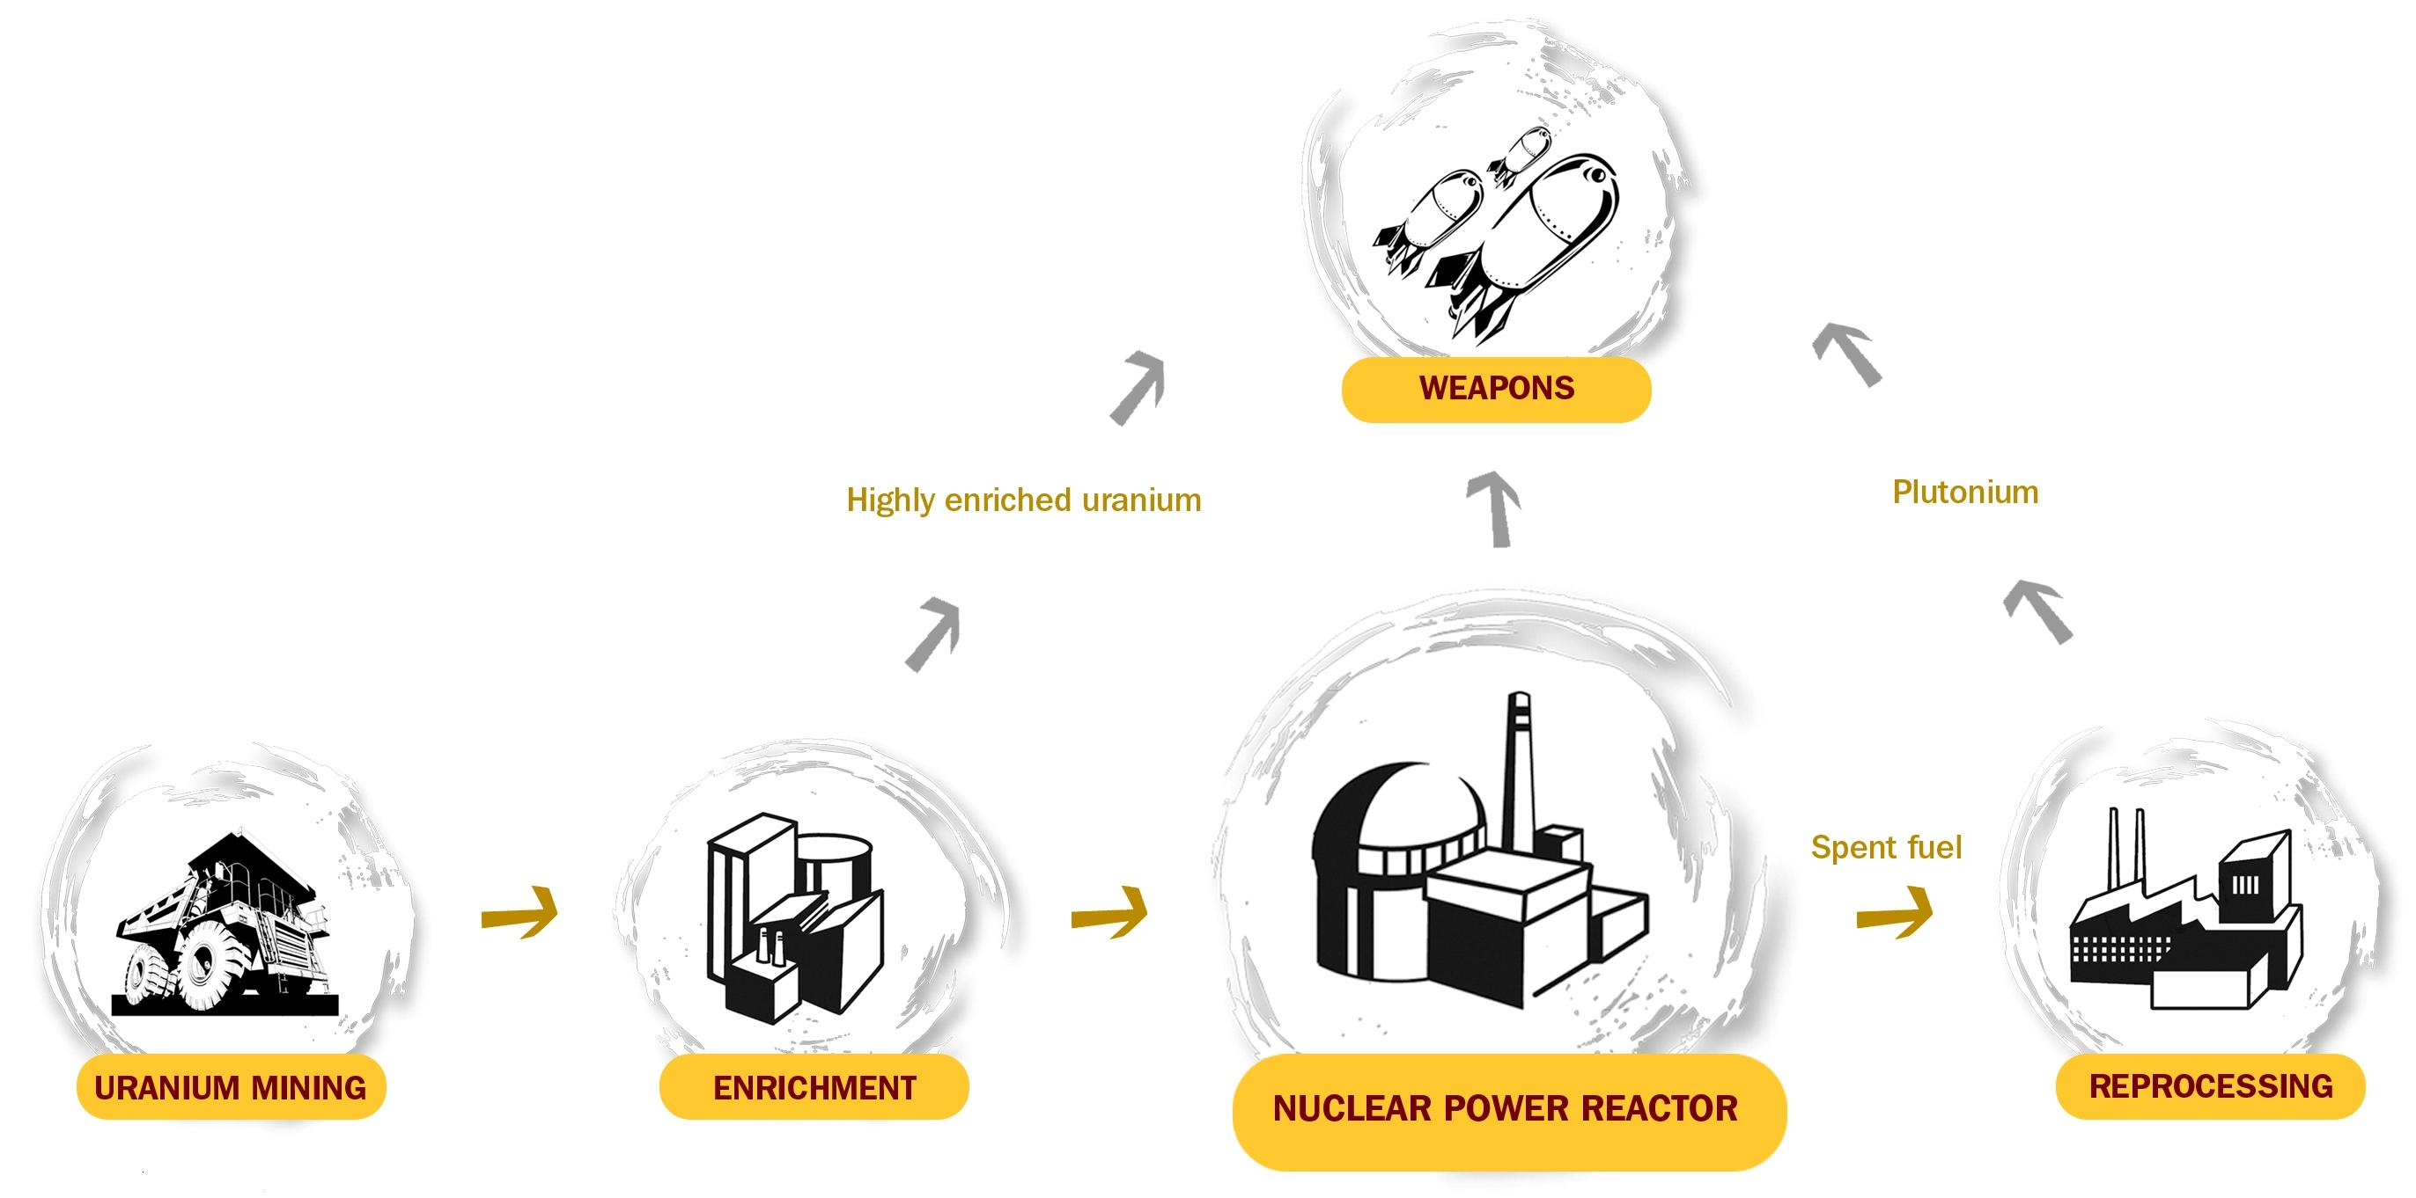

Slide 25
Nuclear proliferation- turning a blind eye
Mohamed ElBaradei,
former director of the U.N. nuclear watchdog International Atomic Energy Agency, 1997-2009.
Countries with nuclear power capabilities are “only a short step away from a nuclear weapons capability.”
https://www.iaea.org/newscenter/statements/nuclear-power-looking-future

Slide 26
The IAEA has limited powers and is under-resourced
Mohamed ElBaradei:
the IAEA's basic rights of inspection are "fairly limited"
the safeguards system suffers from "vulnerabilities" and it "clearly needs reinforcement"
efforts to improve the system have been "half-hearted"
The safeguards system operates on a "shoestring budget ... comparable to that of a local police department".

Slide 27
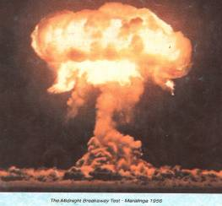
"For eight years in the White House, every weapons-proliferation problem we dealt with was connected to a civilian reactor program.
And if we ever got to the point where we wanted to use nuclear reactors to back out a lot of coal ... then we'd have to put them in so many places we'd run that proliferation risk right off the reasonability scale."
-- Al Gore

Slide 28
Nuclear facilities are a recognised target
Conventional military strikes on nuclear plants, driven by proliferation fears have occurred in Iraq, Israel and Syria

Slide 29
Iranian nuclear enrichment
Trump abandons Iran nuclear deal (JCPOA) when first in office
In 2025, Trump opens direct U.S.-Iran nuclear talks
Israel, wholly opposed to the negotiations, launched a unilateral military strike against Iran on June 13 2025 - targeting nuclear facilities, missile factories, senior military officials, and nuclear scientists.
https://www.bbc.com/news/articles/c4g2eggzvjgo
https://www.nytimes.com/live/2025/06/12/world/israel-iran-us-nuclear
https://www.bbc.com/news/articles/ce3v6w2qr12o
https://www.cfr.org/global-conflict-tracker/conflict/confrontation-between-united-states-and-iran
Notes:
—one day after the IAEA declared Iran in violation of its non-proliferation obligations for the first time in twenty years—

Slide 30
A war over nuclear enrichment
After a week of Israeli-Iranian exchanges, the US strikes Iranian nuclear sites in Fordow, Isfahan, and Natanz
Trump is the first U.S. president
  attack another country’s nuclear program and
  to explicitly join Israel in an attack on an adversary.
https://www.cfr.org/articles/us-israel-attack-iranian-nuclear-targets-damage-so-far
https://www.economist.com/middle-east-and-africa/2025/06/22/mission-accomplished-for-netanyahu

Slide 31
And it continues
US and Israel attacked Iran on February 28, 2026
Iran missile and drone strikes
  against U.S. military facilities in Bahrain, Jordan, Kuwait, Qatar, and the United Arab Emirates, as well as against
  energy and civilian infrastructure, including airports and oil facilities.’
  Egypt and Iraq most recently- broadening into a region wide conflict
https://www.theguardian.com/world/2025/jun/29/iran-will-likely-be-able-to-produce-enriched-uranium-in-a-matter-of-months-iaea-chief-says
https://www.cfr.org/global-conflict-tracker/conflict/confrontation-between-united-states-and-iran
https://www.aljazeera.com/news/2026/7/19/kuwaiti-power-plant-ablaze-as-iran-hits-us-gulf-allies
https://www.cfr.org/articles/gauging-the-impact-of-massive-u-s-israeli-strikes-on-iran

Slide 32
What’s next…
Pickaxe Mountain is ⁠located 220km (140 miles) south of ⁠Tehran and 2km (1.2 miles) from the ​Natanz nuclear facility
Iran plans still unclear
Experts assess the deeply buried complex as being beyond the reach of the most powerful bunker buster bombs in the US arsenal
https://www.theguardian.com/world/2026/jul/22/pickaxe-mountain-iran-nuclear-site-trump

Slide 33
Saudi Arabia deal
Opaque – US industry keen.
Maybe linked to recognition of Israel and no enrichment ???
Does not require sign on to IAEA additional protocol
(compared to 2009 UAE deal which prohibited uranium enrichment and spent fuel reprocessing and sign on to additional protocol)
Extraordinary given Israel/US attacks on Iran were explicitly to stop their enrichment program

Slide 34
OTHER WEAPONS-RELATED THREATS
Accidents
Unstable leaders
Nuclear theft / smuggling
Nuclear terrorism and sabotage
AI enabled cyber tools
AI itself…?

Slide 35
Nuclear power
Too slow
Too expensive (however many vested interests keen)
Too dirty
Too dangerous
Thanks

