Slide 1
Is Nuclear Power the Solution to Climate Change?
Friends of the Earth Adelaide
July 30 2026
Dr Paul Dorfman

Slide 2
Climate impact
Nuclear is, quite literally, on the front-line of climate risk – and not in a good way.
https://bennettinstitutesussex.org/stories/nuclear-is-too-late-and-too-costly-for-the-climate-crisis/

Slide 3
Coastal
With more frequent and destructive storms, storm surges and floods, extreme events become the norm and existing flood risk mitigation measures become obsolete.
This puts coastal nuclear on the front-line of climate change—and not in a good way.
Globally, 41% of nuclear plants are coastal.
Since the climate risks that nuclear faces due to rising sea levels won’t be linear, nuclear construction, operation, waste management, and decommissioning will become significantly more expensive.

Slide 4
UK Inst.Mechanical Engineers (IME) : ‘Adapting to the Inevitable’
IME: Coastal nuclear sites will need ‘considerable investment’ to protect them against rising sea levels, and even ‘relocation or abandonment.’
https://www.imeche.org/policy-and-press/reports/detail/climate-change-adapting-to-the-inevitable

Slide 5
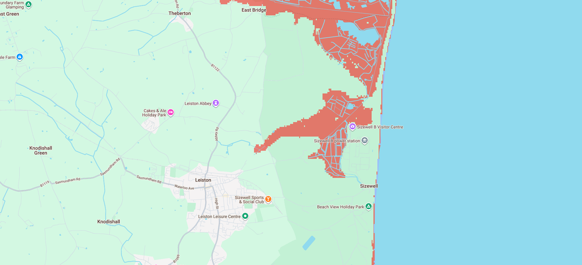
https://coastal.climatecentral.org/map/14/1.5989/52.212/

Slide 6
Inland
'Wildfires darken the clouds over France's Bordeaux wine industry.' And just over the Garonne lies Blayais nuclear power plant.
Episodic flooding alternating with low river-flow and increased water temperature - profound adverse effects on reactor cooling and discharge.
French EDF reactors shut down at Golfech, Bugey and Chooz plants, on the banks of the Garonne, Rhone and Meuse rivers.
Danube river low-flow has shut down 1 GW of nuclear in Romania and Hungary, with record low water levels affecting cooling.

Slide 7
US
US Nuclear Regulatory Commission: Majority US nuclear sites already experienced flooding hazard beyond design-base.
US Army War College: Nuclear power facilities at ‘high risk’ of temporary or permanent closure due to climate threats – with 60% US nuclear capacity now vulnerable to sea-level rise, severe storms, and cooling water shortages.
61% US nuclear energy facilities expected to face water stress by 2030, potentially forcing them to reduce generation or shut down.

Slide 8
Cost
Nuclear build has a doubling cost overrun.
Lazard’s levelized cost of energy (LCOE) for new nuclear is £109 per MWh, making it the most expensive energy source.
Unsubsidized solar and wind combined with energy storage (for grid balancing) four times cheaper.

Slide 9
Time
Cost is key, but time is the most critical variable - and it’s running out.
UK Govt. Global data: Including planning and approval, one new nuclear station takes 17 years plus. New nuclear in Europe hugely behind schedule and vastly over budget. SMR’s still in development, and decades from any commercial deployment.
Former Chair of the US Nuclear Regulatory Commission: “Not enough time for nuclear innovation to make a realistic impact on the climate crisis.”
Intergovernmental PaneI on Climate Change (IPCC) AR6 Report: Renewables are now 10 times more effective at cutting carbon dioxide (CO2) emissions than new nuclear.

Slide 10
Pace
Wind and solar now dominate global electricity generation.
2025 wind and solar overtook EU fossil fuel power generation.
Norway just said no to nuclear.
NATO now backs renewables as solution to energy security.
UK Chatham House: Renewables hold the key to energy security in the European Union (EU).
Solar grew by more than 20% in a single year, proving that clean power can scale faster than other technologies.
Challenge now is not generation, but how quickly grids, batteries and flexibility can be deployed.

Slide 11
Storage
UK Royal Society: Renewables plus long-duration storage cheaper than any system that includes nuclear.
Solar delivered fastest energy transition in history - set to be beaten by battery energy storage systems, with current cumulative global installed capacity of 690 gigawatt hours (GWh) and rising.
Battery energy storage to grow six-fold worldwide by end of decade.
Australia: Home battery rebates adding 2,000 systems a day as total hurtles towards half a million installations.

Slide 12
Renewable evolution
Unlike the ‘nuclear renaissance’, the renewable evolution is here and now – on-schedule and cost-effective.
We can mitigate climate impact and sustain reliable power system by expanding renewable energy in all sectors, rapid growth and modernization of the electricity grid, storage technology roll-out, faster interconnection, and using power far more effectively and efficiently via rational energy management.

Slide 13
Renewable evolution
All key international and national energy organizations/institutes agree that renewables will do heavy-lifting for the energy transition.
Future backbone of the global energy supply system will be renewable, sustainable, and cost-effective.
Nuclear is already too late and too costly to play any positive role in tackling the climate and energy crises.

Slide 14
Renewable evolution
At a time when so much looks grim, the renewable revolution offers real hope.
In 2025, more power was generated worldwide from renewable energy than from coal.
91% of new renewables are now cheaper than fossil fuels.
UN confirms renewables increased their lead over fossil fuels and nuclear via economies of scale, technology innovation, and supply chain roll-out.
Each year nuclear adds only as much net global power capacity as renewables add every two days.

Slide 15
Dr Paul Dorfman, Bennett Scholar, Bennett Institute, University of Sussex
‘New Nuclear Is Too Late and Too Costly for the Climate Crisis.’
https://bennettinstitutesussex.org/stories/nuclear-is-too-late-and-too-costly-for-the-climate-crisis/
‘Scotland at the Crossroads: Why Renewables Are Outpacing Nuclear in the Race Against Time.’
https://bennettinstitutesussex.org/stories/scotland-at-the-crossroads-why-renewables-are-outpacing-nuclear-in-the-race-against-time/
‘Renewables evolve – fossil fuels ‘run out of road’
https://bennettinstitutesussex.org/stories/renewables-evolve-fossil-fuels-run-out-of-road/

Slide 16
Urgewald
‘Debt, Delays, Dependencies: Why Public Banks Should Not Support Nuclear Power - New nuclear: Too late and too costly for the climate and energy crises’.
https://www.urgewald.org/sites/default/files/media-files/Urgewald%20-%20Debt%2C%20Delays%2C%20Dependencies%20Report-April-2026.pdf

