Slide 1
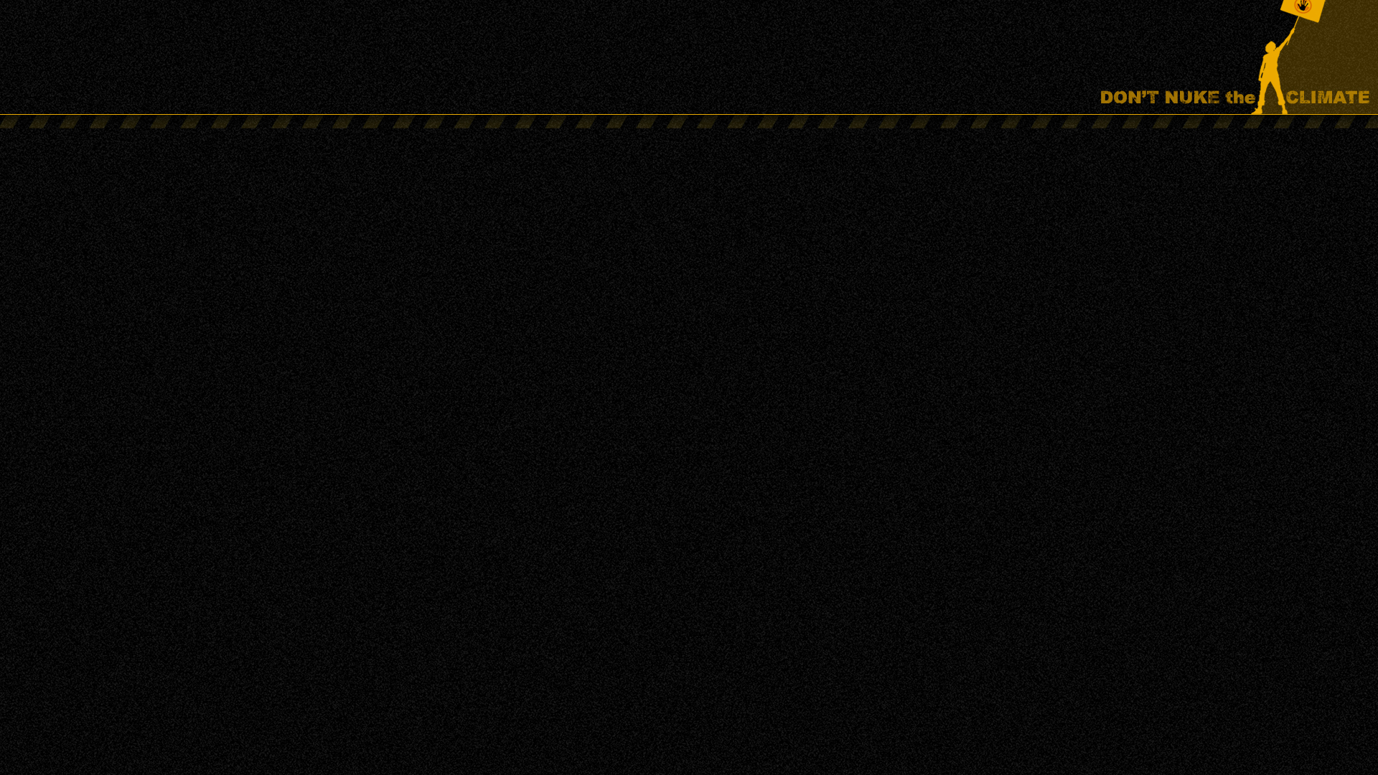
Nuclear power’s stagnation and decline
LIES:
Nuclear power is expanding worldwide, 50 countries planning to introduce nuclear power, Australia risks being left behind, etc.
FACTS:
Globally, nuclear power generation has been stagnant for the past 25 years
Nuclear power’s share of global electricity generation has fallen to 8.7 percent, less than half its historic peak of 17.5 percent in 1996
The number of countries building reactors has fallen from 16 to 11 over the past 2 years
7 percent of the world’s countries are building reactors, 93 percent are not.
The number of countries operating reactors reached 32 in the mid-1990s, now it is 31
16 percent of the world’s countries operate reactors, 84 percent do not

Slide 2
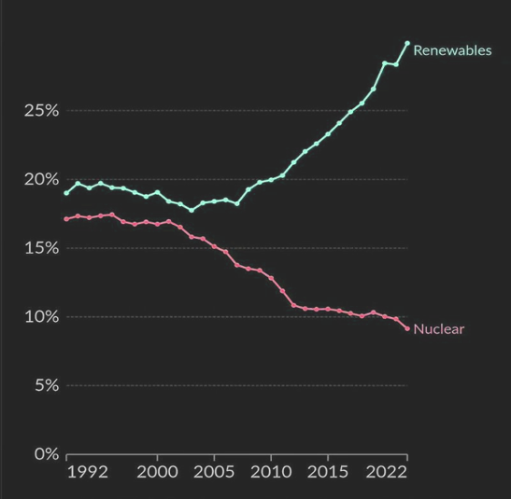
Nuclear decline vs renewables growth
Nuclear power has fallen to 8.7 percent of global electricity generation, while renewables have increased to 32 percent.
The International Energy Agency expects renewables to reach
43 percent by 2030.
International Energy Agency: From 2025-2030, renewables are expected to meet over 90 percent of global electricity demand growth.
Renewables currently generate 3 times more electricity than
nuclear power, by 2030 it will be 5 times more than nuclear.
Last year, nuclear growth of 4 gigawatts was 180 times lower
than renewables growth of 666 gigawatts.
Only one power reactor under construction across the 35
countries on the American continent. Only one across the 27 EU countries.
China: 2.5 gigawatts of new nuclear in 2025, > 275 gigawatts of
new solar capacity.

Slide 3
Nuclear power costs too much
Cost of recent reactor projects in the US, UK and France: A$21.3 billion to A$30.6 billion per gigawatt.
CSIRO GenCost report, Dec. 2024 For discussion see reneweconomy.com.au/?s=gencost
 | 2024 (A$ / MWh)
Nuclear – small modular | 400-663
Nuclear – large-scale | 155-252
90% solar PV + wind including storage costs | 106-150

Slide 4
Nuclear power is too slow
Introducing nuclear power to Australia would necessitate:
At least 10 years for planning and licensing
Around 10 years for construction
An estimated 6.5 years of reactor operation to repay the energy and carbon debts from construction
So nuclear power could not even begin to contribute to greenhouse emissions reductions until 2050 at the earliest.
The Coalition claims to support net zero by 2050 but CSIRO states that nuclear power “won’t be able to make a meaningful contribution to achieving net zero emissions by 2050.”
Former Australian Chief Scientist Dr. Alan Finkel says: “Any call to go directly from coal to nuclear is effectively a call to delay decarbonisation of our electricity system by 20 years.”

Slide 5
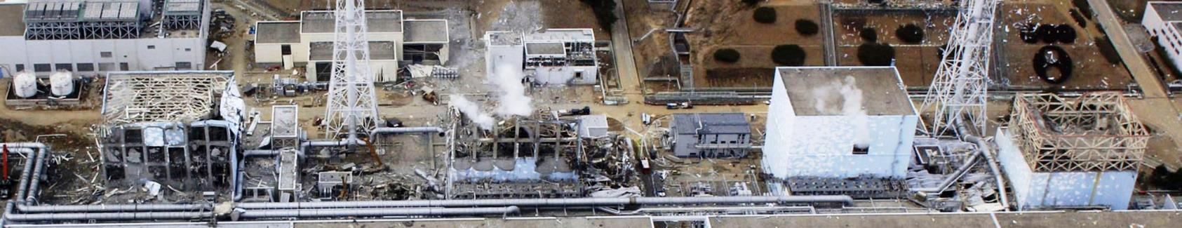
Too slow, too expensive … and too risky
Catastrophic accidents
Nuclear weapons proliferation
Military/terrorist attacks on nuclear plants such as Russia’s attacks on multiple nuclear plants in Ukraine … and recent attacks on nuclear plants in Iran and the UAE

Slide 6
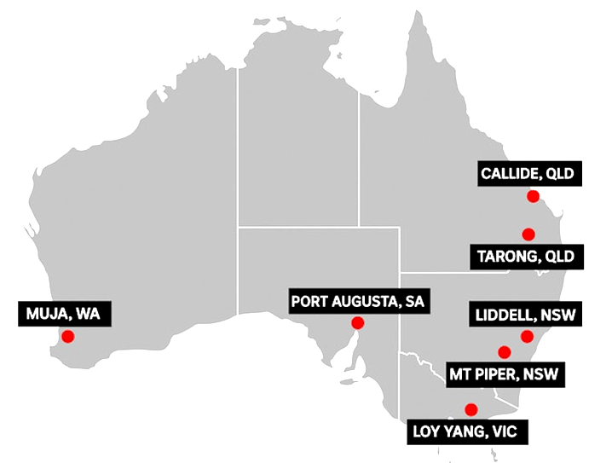
Dutton’s nuclear power plan
Nuclear power reactors at 7 sites in 5 states.
A total of about 15 reactors (13-14 gigawatts capacity)
Non-existent ‘small modular reactors’ in SA and WA. Large reactors in the eastern states.
Government (i.e. taxpayer) funded … because the private sector wouldn’t touch any of this with a barge-pole unless gifted many billions of taxpayer dollars.
The Dutton Coalition’s energy policies would have increased greenhouse emissions by 1.7 billion tonnes by 2050

Slide 7
Current policies
Coalition:
promotes repeal of laws banning nuclear power
rejects serious efforts to address climate change
One Nation:
promotes repeal of laws banning nuclear power, plus at least one taxpayer-funded nuclear power plant to be built on the east coast
rejects serious efforts to address climate change
Almost all other political parties and politicians (inc. teal independents):
continue the renewables transition, reject nuclear power
‘Nuclear for Australia’ lobby group
Chair Adi Paterson on public concern about climate change: “irrational fear of a trace gas which is plant food”
    nuclear.foe.org.au/will-shackel-nuclear-for-australia

Slide 8
More information
All of tonight’s PowerPoints: nuclear.foe.org.au/energy
Don’t Nuke the Climate: dont-nuke-the-climate.org.au
Friends of the Earth: nuclear.foe.org.au
ACF, Nov. 2025 report: Hot Politics: The Case Against Nuclear Power in Australia
    Too Slow
    Too Expensive
    Industry Opposition
    Nuclear Accidents
    Warnings from First Responders
    Nuclear Waste
    Water Consumption
    Small Modular Reactors
    Public opinion
Scott Ludlam and Kirsten Blair, Electoral Fallout: Nuclear Power and the 2025 Election
Getup!, 2024, Exposing Pro-Nuclear Disinformation in Australia

