Slide 1
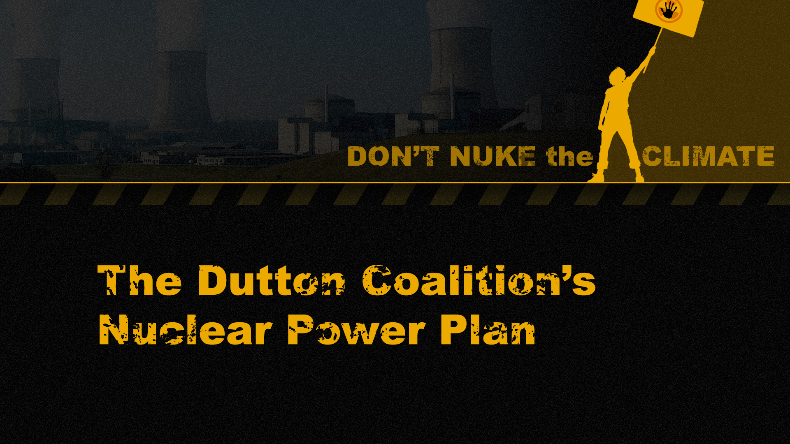
Dr. Jim Green

Slide 2
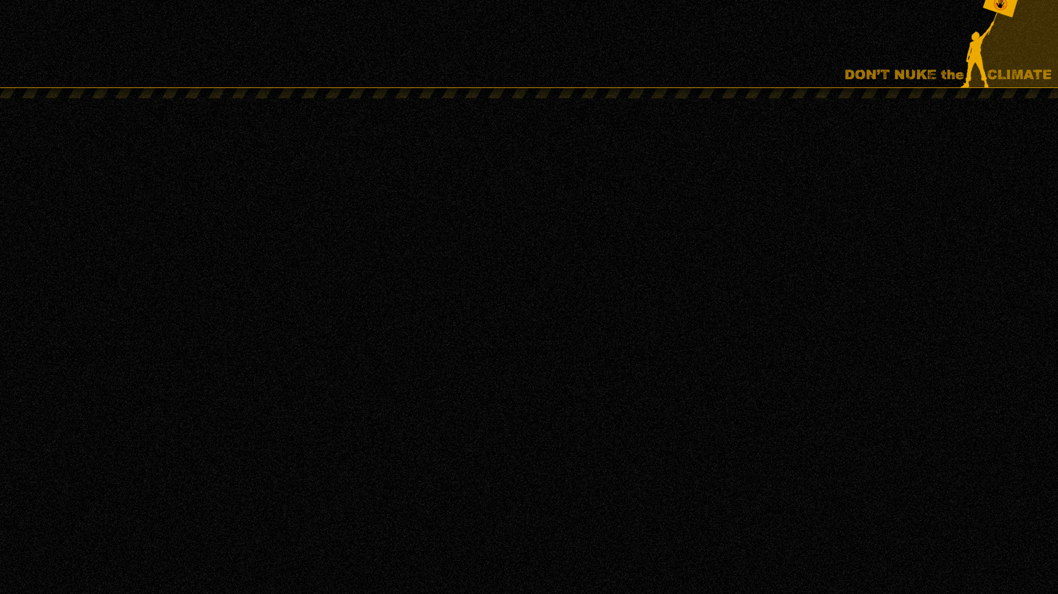
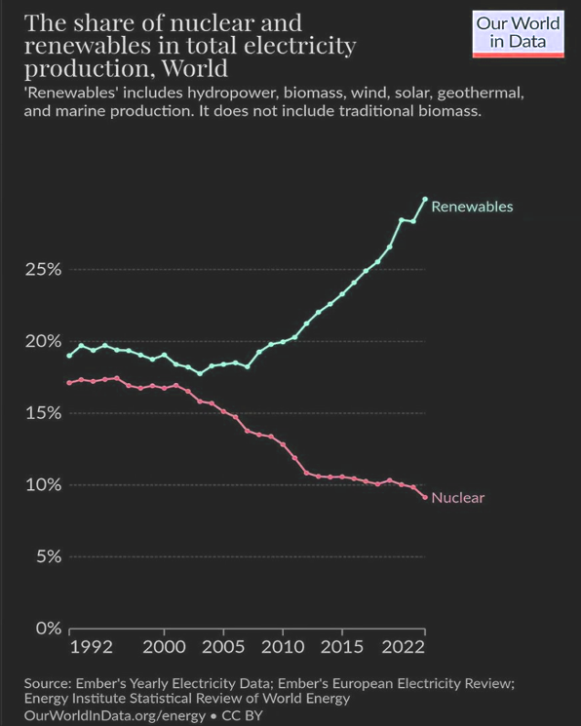
International context
Nuclear power has fallen from its peak of 17.5% of global electricity generation to just 9.2% now.
Renewables have grown to 30.2% and the International Energy Agency expects renewables to reach 42% by 2028.
Main reasons:
  Massive cost reductions for renewables and batteries
  Massive cost increases for nuclear power
  The Fukushima disaster

Slide 3
International context
USA:
  Construction of two reactors in South Carolina abandoned in 2017 after the expenditure of around A$13.6 billion. Westinghouse filed for bankruptcy protection.
  The only remaining construction project, two AP1000 reactors in the state of Georgia (known as the Vogtle project), was recently completed at an astronomical cost of approx. A$25.7 billion per reactor.
  The Dutton Coalition is promoting AP1000 reactors!
  Zero nuclear power reactors now under construction in the USA
UK:
  The cost of the two EPR reactors under construction at Hinkley Point - the only reactors under construction in the UK - has escalated to A$43.5 billion per reactor.
  South Korea:
  South Korea’s nuclear industry is riddled with corruption and its APR1400 reactor design has been likened to “a car without airbags and safety belts.”
  China:
  1 gigawatt of new nuclear power capacity in 2023 compared to 278 gigawatts of new renewable capacity.

Slide 4
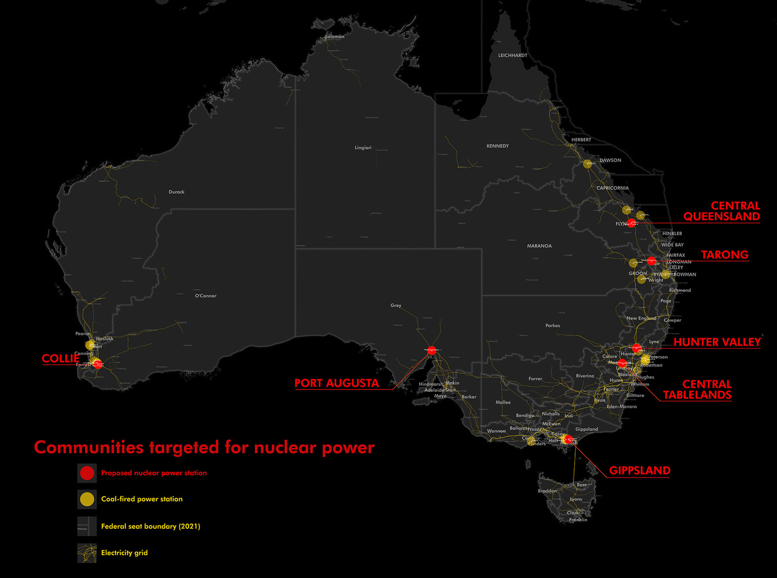
The Coalition’s nuclear plan
  Nuclear power reactors at 7 closed or soon-to-be-closed coal power sites.
  Unknown number of reactors at each of the 7 sites.
  Non-existent ‘small modular reactors’ in SA and WA. Large reactors in the eastern states.
  Government funded.
  First reactors operating in the mid-2030s but in reality they couldn’t begin operating until the mid-2040s.
  If realised, the nuclear reactors might produce about 10% of Australia’s electricity demand by 2050.

Slide 5
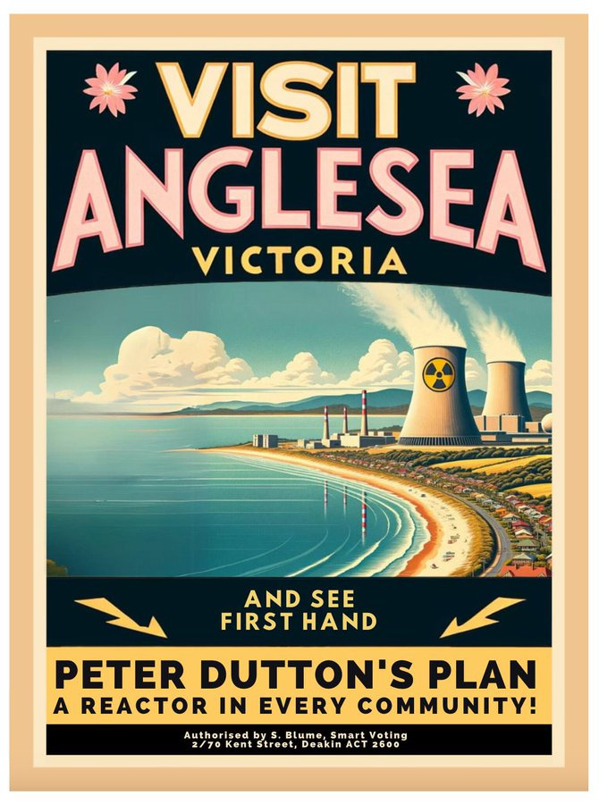
Could a Coalition government deliver?
Yes, a Coalition government could use taxpayer funds.
Yes, a Coalition government could override opposition from state governments (including state legal bans).
Yes, a Coalition government could use compulsory acquisition laws to acquire the coal power sites from the current owners (who are pursuing renewable energy and storage projects and have no interest in nuclear power).
Yes, a Coalition government could override opposition from local communities and First Nations.
But a Coalition government would need to get legislation through the Senate and that might be an obstacle.

Slide 6
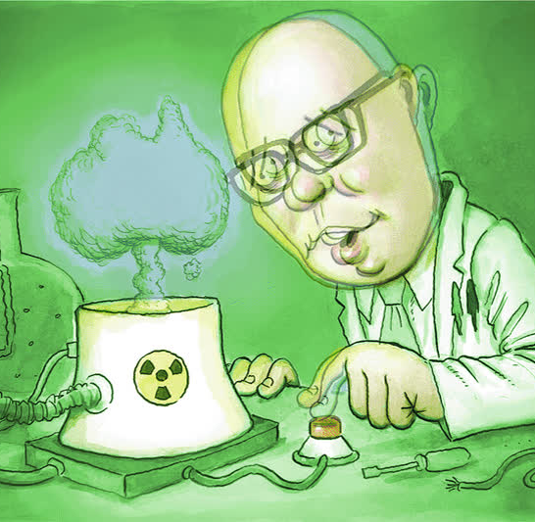
Greenhouse gas emissions
IF IT WAS A GOOD-FAITH COALITION POLICY TO REDUCE GREENHOUSE EMISSIONS …
Nuclear power would slow the transition to low-carbon power, and make it more expensive and more dangerous. Renewables would do the heavy lifting.
BUT IT IS NOT A GOOD-FAITH POLICY TO REDUCE GREENHOUSE EMISSIONS
The Dutton Coalition wants to derail the transition to low-carbon power and to:
  Prolong the life of coal plants and probably build new coal plants.
  Massively increase the use of gas power (currently just 4.8% of electricity generation in the National Electricity Market).
  Malcolm Turnbull says the [climate] “science denying” element in the Coalition is “crazy, and to some extent getting crazier”.

Slide 7
Derailing the renewable energy transition
The Coalition:
  Plans to abandon the current government’s target of 82% renewables by 2030
  Opposes the current government’s target to cut emissions by 43% by 2030 (the Coalition will not establish 2030 or 2035 targets).
  Plans to rip up contracts signed by the Commonwealth in its Capacity Investment Scheme.
  The Nationals are calling for a moratorium on the rollout of large-scale renewables and that will probably become formal Coalition policy.
  Withdraw Australia’s pledge at the 2023 COP28 UN climate conference to triple renewable energy and double the rate of energy efficiency by 2030.
  Plans to sign Australia up to a COP28 pledge to triple nuclear power by 2050.
  Queensland National Party Senator Matt Canavan says the Coalition intends to shut down the Climate Change Authority. The Abbott government defunded the independent Climate Commission and tried but failed to kill off the Climate Change Authority and the Australian Renewable Energy Agency.

Slide 8
Massive increase in greenhouse gas emissions
  Slowing the growth of renewables = more fossil fuels = greater greenhouse emissions.
  Coal plants will be shut down in the next 10-15 years but nuclear reactors couldn’t begin operating until 20+ years. Bridging the gap with fossil fuels = greater greenhouse emissions.
  CSIRO: nuclear won’t be able to make a meaningful contribution to achieving net zero emissions by 2050
  Nuclear power “won’t be able to make a meaningful contribution to achieving net zero emissions by 2050.”
  Australia will not come close to net zero by 2050 under Coalition’s nuclear plan
  Academics George Wilkenfeld and Clive Hamilton: “The Coalition’s nuclear strategy would increase Australia’s cumulative emissions over the period to 2050 by at least 1,462 Mt CO2-e compared with the renewables pathway.”
  Nuclear reactors a disaster for climate emissions
  An analysis by Solutions for Climate Australia has found that pursuing nuclear reactors in Australia would result in an additional 2.3 billion tonnes of climate emissions between now and 2050.
  Nuclear could ‘sound the death knell’ for Australia’s decarbonisation efforts, report says
  A report by Bloomberg New Energy Finance finds that nuclear-power would result in higher electricity costs and would “sound the death knell” for decarbonisation efforts if it distracts from renewables investment.
  Australia’s ‘carbon budget’ may blow out by 40% under the Coalition’s nuclear energy plan
  UTS academic Sven Teske: Even if the reactors are built, the negative impact on Australia’s carbon emissions would be huge. Over the next decade, the renewables transition would stall and coal and gas emissions would rise – possibly leading to a 40% blowout in Australia’s carbon budget.

Slide 9
What do scientists say?
  Australia's Chief Scientist Cathy Foley says nuclear power is “expensive” and “it would take some time to build up the capability” to introduce it.
  Former Australian Chief Scientist Alan Finkel says that nuclear power is “too slow and too expensive” for Australia.
  Another former Australian Chief Scientist, Robin Batterham, says that: “To reduce renewable targets in the belief that nuclear will be deployed later at scale would create a material risk of not achieving net zero, or doing so at an excessive cost.”
  NSW Chief Scientist Hugh Durrant-Whyte says that it would be "naive" to think a nuclear power plant could be built in Australia in less than two decades.
  Australia’s leading scientific organisation CSIRO says that nuclear power “does not provide an economically competitive solution in Australia” and could not be deployed “within the timeframe required.”
  The Climate Council ‒ including many of Australia's leading climate scientists ‒ states that nuclear power plants "are not appropriate for Australia – and never will be", and that nuclear power is “expensive, illegal, dangerous and decades away”.
  A report by the Australian Academy of Technological Sciences and Engineering (ATSE) notes that no small modular reactors exist in any OECD countries and the technology is unproven technically and financially.

Slide 10
Too slow
Introducing nuclear power to Australia would necessitate:
  At least 10 years for: licensing, vendor selection, site selection, regulation, Commonwealth/state negotiations, workforce recruitment and training; an environmental impact assessment process; legislative reform, etc.
  Around 10 years for construction; and
  An estimated 6.5 years of reactor operation to repay the energy and carbon debts from construction.
  So nuclear power couldn’t contribute to greenhouse emissions reductions until ~2050.
  Overseas examples
  USA Vogtle project: 18 years for planning and construction.
  France: 17+ years just for construction.
  UK: 20-25+ years for planning and construction.
  Finland: 17 years just for construction.
  The Coalition’s claim that reactors could be operating by the mid-2030s is nonsense.
  Former Australian Chief Scientist Dr. Alan Finkel: “Any call to go directly from coal to nuclear is effectively a call to delay decarbonisation of our electricity system by 20 years.”

Slide 11
Too expensive
ACF ‘Power Games’ report
  Comparing costs of large reactors in the UK and US, and SMR cost estimates, with CSIRO estimates for firmed renewables, nuclear costs (large or small) would need to come down by two-thirds to be competitive with firmed renewables.
  Replacing Australia’s 21.3 gigawatts of coal plants with nuclear, large or small, would cost $500 billion to $650 billion (and much more to train a nuclear workforce)
  Levelised cost of electricity review
  A report prepared for the Clean Energy Council by Egis, a leading global consulting, construction and engineering firm. May 2024 found that Nuclear power is up to six times more expensive than renewable energy.
  Nuclear is unviable because of economics, not engineering
  Even if all that mattered was the cheapest possible energy that meets minimum levels of reliability and emissions, the Coalition's plan fails.
  June 23, 2024, Australian Financial Review, Steven Hamilton and Luke Heeney
  Power bills could rise by $1,000 a year under Coalition plan
  Annual household power bills could increase by hundreds of dollars, and up to $1,000, under a Coalition plan to slow the rollout of large-scale renewable energy and use more gas-fired electricity before nuclear plants are ready, analysts say.

Slide 12
Too expensive
Coalition’s taxpayer-funded nuclear con a
road to ruin
Tim Buckley and Annemarie Jonson, 25 June 2024, Australian Financial Review
It beggars belief that the alternative government proposes nationalising an uncosted nuclear debt bomb and detonating it at the heart of domestic energy and climate policy.
We estimate that the fiscal damage would be in the order of a minimum $100 billion, but likely considerably more given the international experience.
Dutton’s nuclear plan could cost up to $600 billion
Using data from the CSIRO’s latest GenCost report and the Australian Energy Market Operator’s Integrated System Plan, the Smart Energy Council estimates the cost to taxpayers of building 7 reactors to be at least $116 billion. Cost overruns could mean a $600 billion bill to Australian taxpayers.
CSIRO GenCost report, May 2024
 | 2023 ($/MWh) | 2030 ($/MWh)
Large-scale nuclear | 155-252 | 141-233
Small modular reactors | 387-641 | 230-382
90% wind and solar PV supply to the National Electricity Market including storage and transmission costs | 100-143 | 89-128
Notes:
12

Slide 13
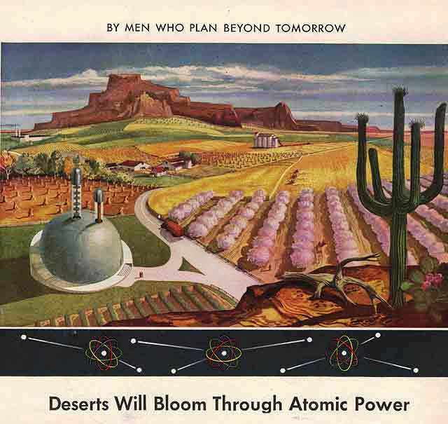
Small modular reactors (SMRs)
Less than 300 MW
Serial factory production of reactor components.
SMRs in China and Russia
  Both countries have one twin-reactor SMR
  No modular construction techniques
  Couldn’t even be called prototype SMRs since there are no plans to mass-produce more.
  SMRs don’t exist.
  Many failed SMR projects, e.g. NuScale in the US abandoned its first project after costs rose to a ridiculous A$14.0 billion for a 462 MW plant.
  More info: nuclear.foe.org.au/smr, reneweconomy.com.au/?s=smr

Slide 14
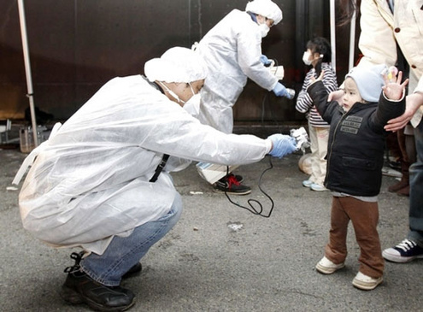
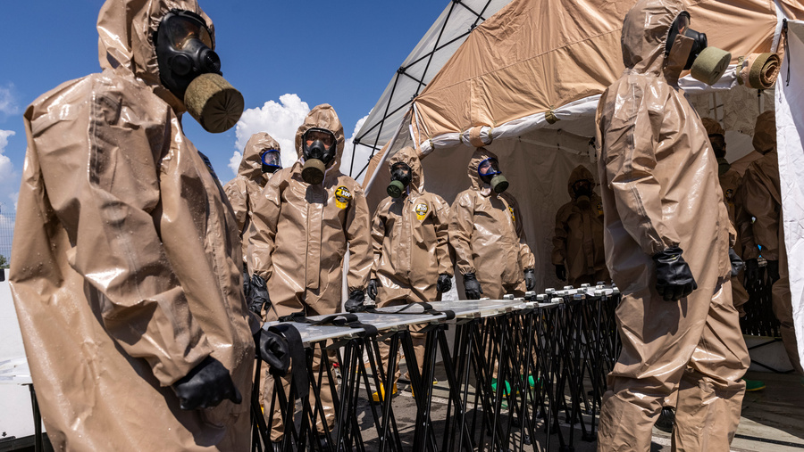
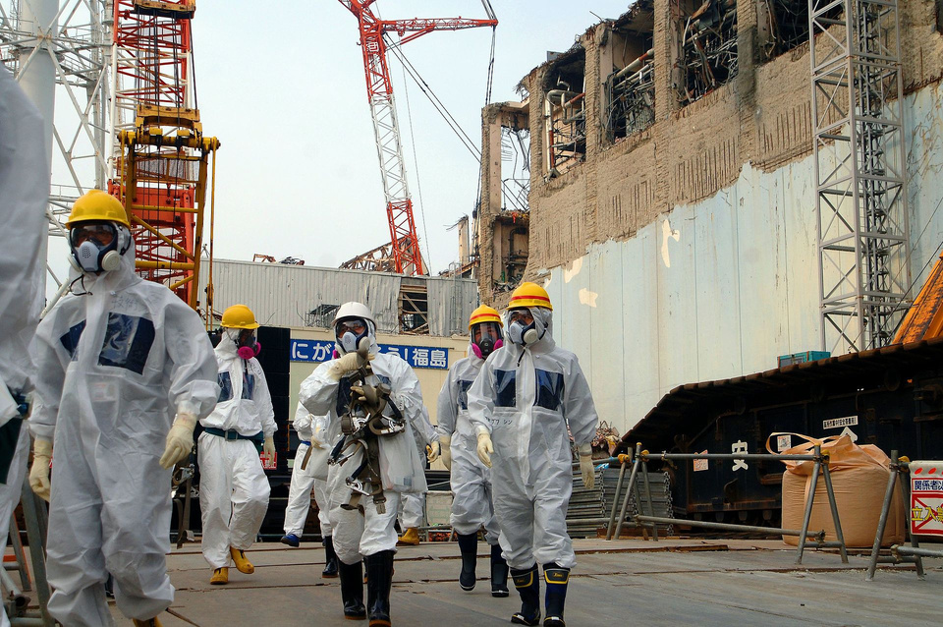
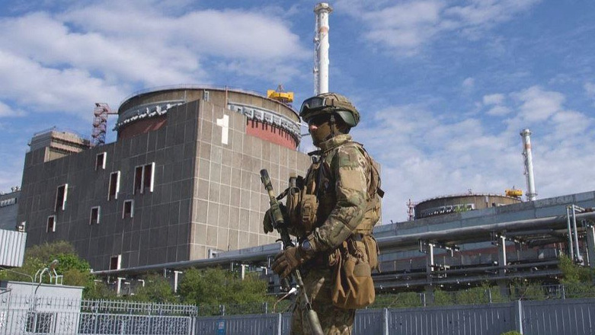
Too risky
  Catastrophic accidents
  Weapons proliferation
  Attacks on nuclear plants

Slide 15
Catastrophic accidents
  The economic costs of the Chernobyl and Fukushima disasters amounted to around A$1 trillion each. In Australia, that would equate to $40,000 for every single citizen.
  Over half a million people were evacuated after the Chernobyl (350,000) and Fukushima (160,000) disasters.
  The lowest scientific estimate of the Chernobyl cancer death toll across Europe is the estimate of 16,000 deaths in a study published in the International Journal of Cancer.
  Radioactive fallout from Fukushima will cause an estimated 5,000 fatal cancers, in addition to the indirect death toll of at least 2,000 people resulting from the botched evacuation and mistreatment of evacuees.

Slide 16
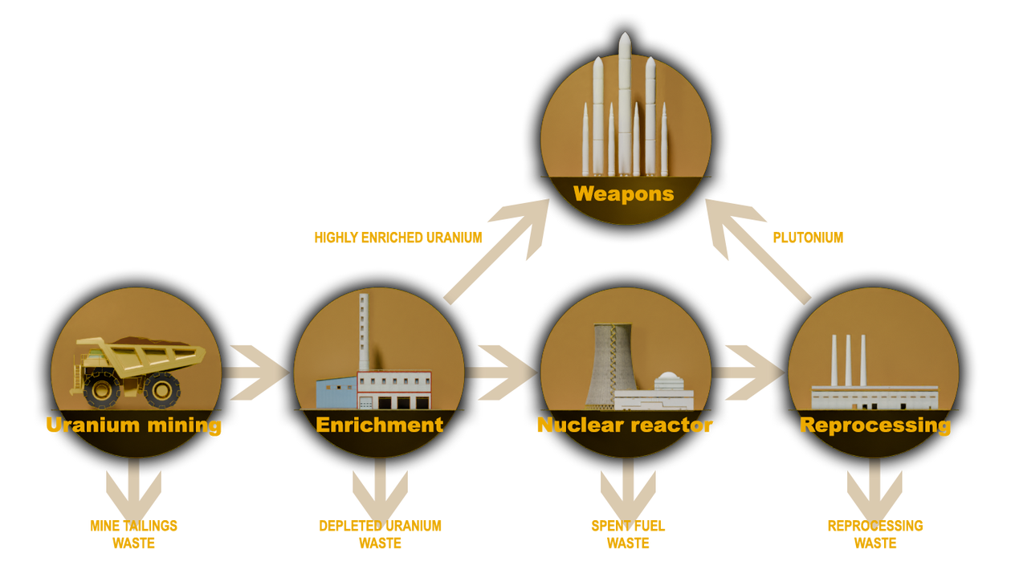
Nuclear Power & Weapons Proliferation
Five of the ten countries that produced nuclear weapons did so under cover of a ‘peaceful’ nuclear program.
Australia pursued nuclear power as a stepping stone to nuclear weapons.
After decades of deceit and denial, the nuclear power industry now openly acknowledges its contribution to weapons proliferation.
nuclear.foe.org.au/power-weapons
Former US Vice President Al Gore:
“For eight years in the White House, every weapons-proliferation problem we dealt with was connected to a civilian reactor program. And if we ever got to the point where we wanted to use nuclear reactors to back out a lot of coal ... then we'd have to put them in so many places we'd run that proliferation risk right off the reasonability scale.”

Slide 17
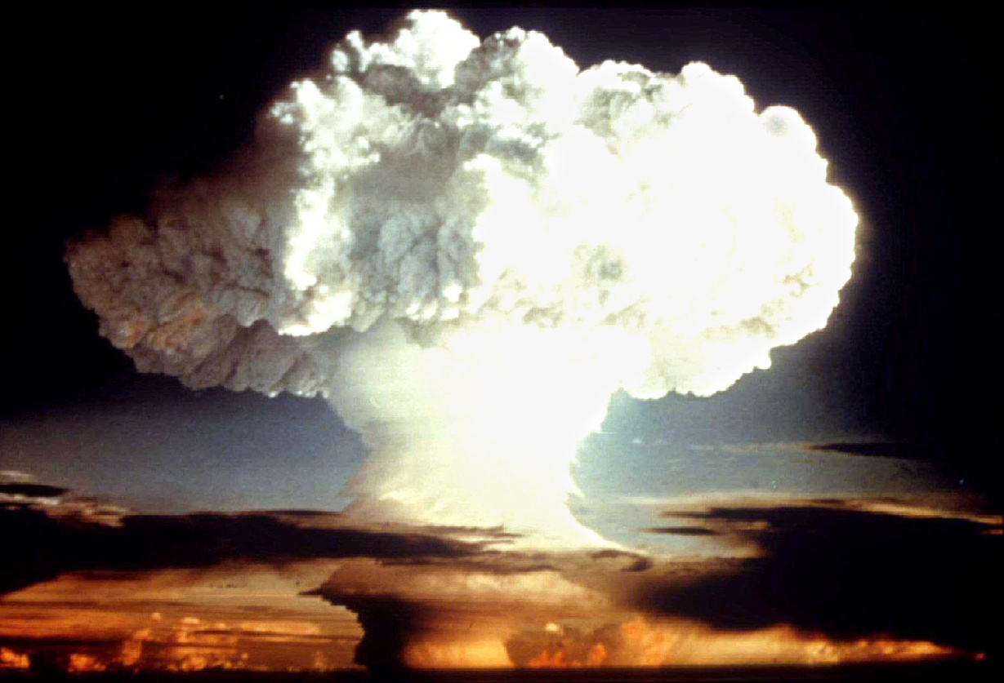
Nuclear Warfare and Climate Change
There are strong connections between nuclear power and nuclear weapons proliferation.
Nuclear warfare has the potential to cause catastrophic climate change by lifting vast amounts of aerosols, smoke, soot and dust into the atmosphere … this is called ‘nuclear winter’.
Fossil fuel burning in the surest route to climate catastrophe. Nuclear warfare is the fastest route to climate catastrophe.

Slide 18
Military attacks on Nuclear Plants
Some examples:
  1981 – Israel destroyed a research reactor in Iraq
  1980-88 – Iran and Iraq targeted each others nuclear sites
  1991 – US destroyed a research reactor in Iraq
  2007 - Israel attacked a research reactor in Syria
  2022 - Russia seized nuclear power sites in Ukraine and bombed nuclear facilities.
  Worst-case scenario:
  Nuclear-powered nations at war risking multiple simultaneous Chernobyl or Fukushima-scale nuclear disasters.
  Emergency response and evacuation difficult or impossible due to surrounding conflict.

Slide 19
Military attacks on Nuclear Plants - Ukraine
IAEA Feb. 2023 report, Nuclear Safety, Security and Safeguards in Ukraine
“Every single one of the IAEA’s crucial seven indispensable pillars for ensuring nuclear safety and security in an armed conflict has been compromised, including the physical integrity of nuclear facilities; the operation of safety and security systems; the working conditions of staff; supply chains, communication channels, radiation monitoring and emergency arrangements; and the crucial off-site power supply.”
Loss of off-site power, and thus reliance on diesel generators to power reactor cooling, sharply increases the risk of nuclear fuel meltdown and significantly increases the risk of a nuclear disaster. The Zaporizhzhia nuclear power plant has lost off-site power 8 times since Russia’s invasion began.
The IAEA report further states:
“Shelling, air attacks, reduced staffing levels, difficult working conditions, frequent losses of off-site power, disruption to the supply chain and the unavailability of spare parts, as well as deviations from planned activities and normal operations, have impacted each nuclear facility and many activities involving radioactive sources in Ukraine.”

Slide 20
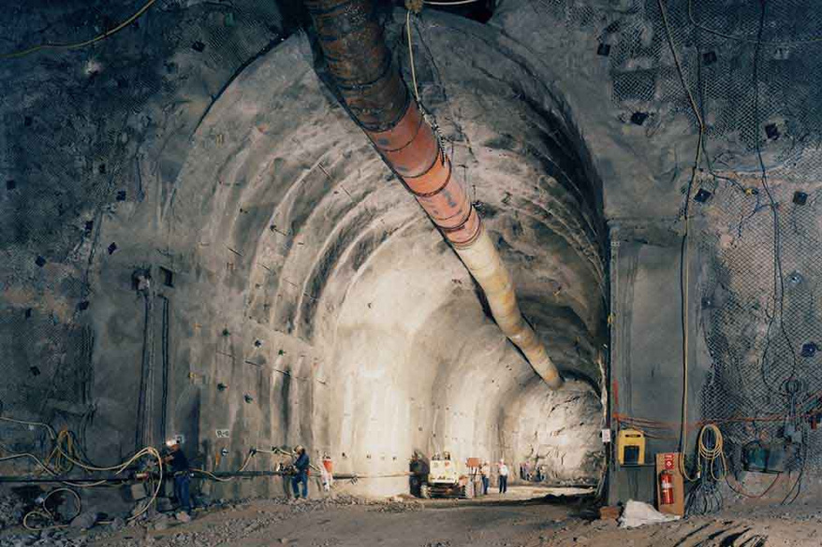
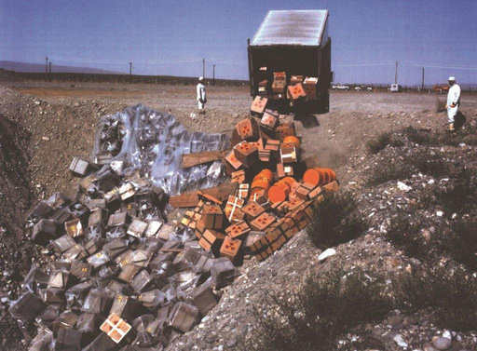
Nuclear Waste
  Zero deep underground repositories for high-level nuclear waste from nuclear power reactors.
  One deep underground repository for intermediate-level waste, ‘WIPP’ in the US state of New Mexico. 2014 underground explosion in a nuclear waste barrel closed WIPP for three years.
  Explosion of a liquid high-level nuclear waste tank at Mayak in Soviet Union in 1957 was one of the world's worst nuclear accidents, 10,000 people evacuated, long-term contamination of more than 800 sq kms.
  Unresolved nuclear waste legacies in Australia: Maralinga, Radium Hill, Woomera, Port Pirie, etc.
  Looming efforts to establish nuclear stores/dumps for Australia’s existing waste (mainly from Lucas Heights) and AUKUS waste.

Slide 21
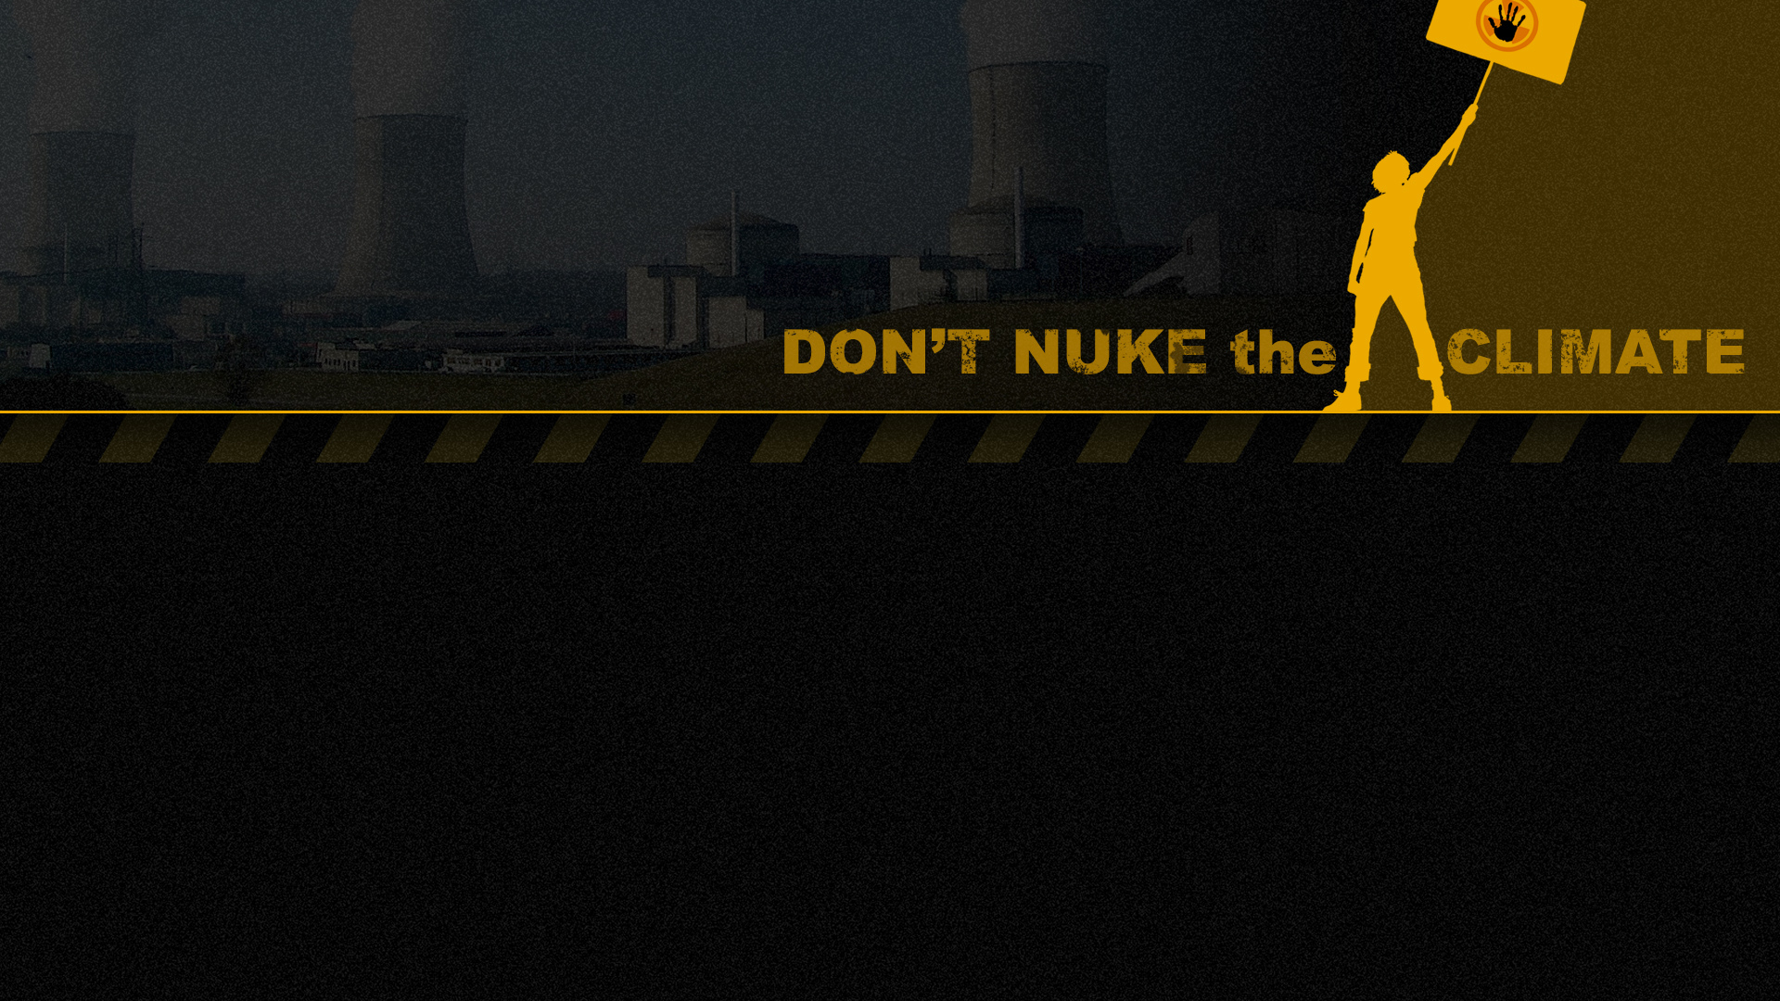
Take Action
Check the Don’t Nuke the Climate website for upcoming actions, petitions and other campaign initiatives:
dont-nuke-the-climate.org.au/takeaction
Go to nonukes.com.au to support the Seven Regions Community Alliance. Sign their petition + get in touch to help out
  Follow our socials and spread them far and wide
  Sign the ACF and FoE petitions – find them on the DNtC website
  help promote our next specialised sessions on health, jobs, water and farming
  Join a train the trainer session on how you can do this presentation in your local community house, church, school sports club etc.
  Have one-on-one conversations with people around you - people change their minds when talking to people they know & trust
  Find your local anti-nuclear group in your region

Slide 22
ACF ‘Power Games’ report
Assessing coal-to-nuclear proposals in Australia
Friends of the Earth
nuclear.foe.org.au
Australian Conservation Foundation
acf.org.au/nuclear-free
RenewEconomy
reneweconomy.com.au/?s=nuclear (and sign up for daily updates)
ETU ‘No Future for Nuclear’
https://nofuture4nuclear.org/
More information
Don’t Nuke the Climate
dont-nuke-the-climate.org.au
(including useful ‘myth busting’ info)
facebook.com/dontnukeaus
x.com/dontnuke

