Slide 1
Dr. Jim Green (jim.green@foe.org.au)
Download this PowerPoint at nuclear.foe.org.au

Slide 2
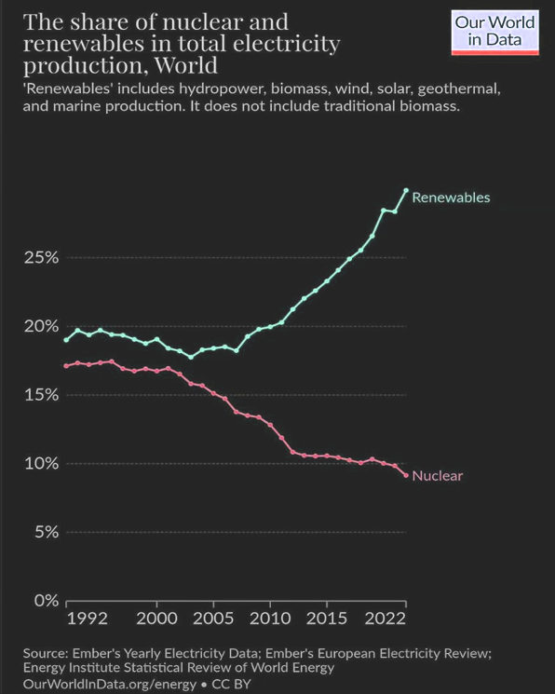
International context
Nuclear power has fallen from its peak of 17.5% of global electricity generation to just 9% now.
Renewables’ share of total electricity production has grown to 30% and the International Energy Agency expects this to reach 42% by 2028.
Main reasons:
Massive cost reductions for renewables & batteries
Massive cost increases for nuclear power
The Fukushima disaster of 2011 and its ongoing consequences

Slide 3
International context
USA
Construction of two reactors in South Carolina was abandoned in 2017 after the expenditure of A$13.6 billion.
Westinghouse filed for bankruptcy protection.
Two AP1000 reactors in Georgia (the ‘Vogtle’ project) were recently completed for A$25.7 billion per reactor … more than 10 times greater than initial cost estimates.
UK
The only two reactors under construction (at Hinkley Point in Somerset) are now set to cost A$43.5 billion each … more than 10 times greater than initial estimates.
France
Only one reactor under construction, the cost has increased six-fold to A$31.7 billion.
Construction began 17 years ago and the reactor remains incomplete.
China
In 2023, only 1 gigawatt of new nuclear power capacity compared to 278 gigawatts of new renewables!
South Korea
South Korea has been promoted as a potential supplier of nuclear reactors to Australia but its nuclear industry is riddled with corruption.
South Korea’s APR1400 reactor design has been likened to “a car without airbags and safety belts.”

Slide 4
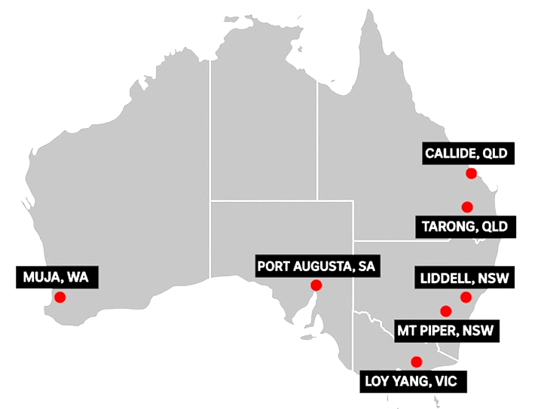
The Coalition’s nuclear power plan
Nuclear power reactors at 7 closed or soon-to-be-closed coal power sites.
Unknown number of reactors at each of the 7 sites.
Non-existent ‘small modular reactors’ in SA and WA. Large reactors in the eastern states.
Government (i.e. taxpayer) funded.
The Coalition says the first reactors will start operating by the mid-2030s but in reality it would be the mid-2040s at the earliest.
If this plan goes ahead, nuclear power might supply about 10% of Australia’s electricity demand by 2050. Definitely not a silver bullet!

Slide 5
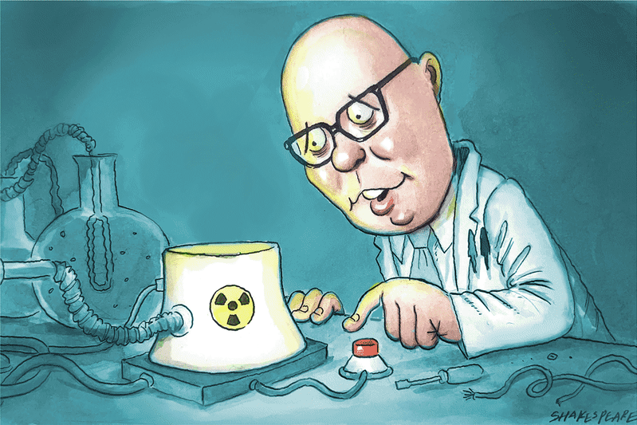
Could a Coalition government really do this?
YES, a Coalition government COULD:
use taxpayer funds
override state governments (including state-legislated bans)
compulsorily acquire coal power sites from current owners (who are pursuing renewable energy and storage projects and have no interest in nuclear power)
override community and First Nations opposition
BUT a Coalition government would need to get legislation passed by the Senate and that might be difficult.

Slide 6
Is this nuclear push REALLY about the climate?
If it was REALLY a policy to reduce carbon emissions with nuclear power and renewables …
Nuclear power could not help reduce emissions until mid-century.
Nuclear power’s contribution would be to slow down the transition to low-carbon power and to make it more expensive and more dangerous than a renewables-led transition.
But it is NOT REALLY about reducing carbon emissions …
The Dutton Coalition wants to derail the current transition to renewables and to:
prolong the life of existing coal plants and even build more
massively increase the use of gas power (currently just 4.8% of electricity generation in the National Electricity Market)
Malcolm Turnbull says the [climate] “science-denying” element in the Coalition is “crazy, and to some extent getting crazier”.

Slide 7
The Coalition’s plan to derail
the renewable energy transition
If elected, a Federal Liberal/National Coalition government will
abandon the current government’s target of 82% renewables by 2030
rip up contracts signed by the Commonwealth in its Capacity Investment Scheme
scrap the current government’s target to cut carbon emissions by 43% by 2030 (the Coalition refuses to establish 2030 or 2035 targets)
withdraw Australia’s pledge (made at the 2023 COP28 climate conference) to triple renewable energy and to double the rate of energy efficiency by 2030
sign Australia up to a COP28 pledge to triple nuclear power by 2050
In addition:
the Nationals are calling for a halt to the rollout of large-scale renewables
Queensland LNP Senator Matt Canavan says the Coalition intends to shut down the Climate Change Authority. (The Abbott government de-funded the independent Climate Commission and tried but failed to kill off the Climate Change Authority and the Australian Renewable Energy Agency.)

Slide 8
A massive increase in carbon emissions
Slowing the growth of renewables = more fossil fuels = greater carbon emissions.
Coal plants will be shut down in the next 10-15 years but nuclear reactors couldn’t begin operating for 20+ years. Bridging the gap with fossil fuels = greater greenhouse emissions.
Australia will not come close to net zero by 2050 under Coalition’s nuclear plan Academics George Wilkenfeld and Clive Hamilton: The Coalition’s strategy would increase Australia’s emissions by at least 1.4 billion tonnes by 2050 compared with the renewables pathway.”
Nuclear reactors a disaster for climate emissions An analysis by Solutions for Climate Australia finds that pursuing nuclear reactors in Australia would result in an additional 2.3 billion tonnes of climate emissions between now and 2050.
Nuclear could ‘sound the death knell’ for Australia’s decarbonisation efforts A report by Bloomberg New Energy Finance finds that nuclear-power would “sound the death knell” for decarbonisation efforts if it distracts from renewables investment.
Australia’s ‘carbon budget’ may blow out by 40% under the Coalition’s energy plan UTS academic Sven Teske: Even if the reactors are built, the negative impact on Australia’s carbon emissions would be huge. Over the next decade, the renewables transition would stall and coal and gas emissions would rise – possibly leading to a 40% blowout in Australia’s carbon budget.

Slide 9
What do scientists say?
Australia's Chief Scientist Cathy Foley says nuclear power is “expensive” and “it would take some time to build up the capability” to introduce it.
Former Australian Chief Scientist Alan Finkel says nuclear power is “too slow and too expensive” for Australia.
Another former Australian Chief Scientist, Robin Batterham, says “To reduce renewable targets in the belief that nuclear will be deployed later at scale would create a material risk of not achieving net zero, or doing so at an excessive cost.”
NSW Chief Scientist Hugh Durrant-Whyte says that it would be "naive" to think a nuclear power plant could be built in Australia in less than two decades.
Australia’s leading scientific organisation CSIRO says that nuclear power “does not provide an economically competitive solution in Australia” and could not be deployed “within the timeframe required.”
The Climate Council ‒ including many of Australia's leading climate scientists ‒ states that nuclear power plants "are not appropriate for Australia – and never will be", and that nuclear power is “expensive, illegal, dangerous and decades away”.
A report by the Australian Academy of Technological Sciences and Engineering (ATSE) notes that no small modular reactors exist in any OECD countries and the technology is unproven technically and financially.

Slide 10
The reality is that nuclear is just too slow!
The Coalition’s claim that reactors could be operating by the mid-2030s is nonsense.
USA Vogtle project: 18 years for planning and construction
UK: 20-25+ years for planning and construction
France: 17+ years just for construction
Finland: 17 years just for construction
Introducing nuclear power to Australia would necessitate:
At least 10 years for planning and licensing
Around 10 years for construction
An estimated 6.5 years of reactor operation to repay the energy and carbon debts from construction
So nuclear power couldn’t contribute to greenhouse emissions reductions until 2050 at the earliest.
The Coalition claims to support net zero by 2050 but CSIRO states that nuclear power “won’t be able to make a meaningful contribution to achieving net zero emissions by 2050.”
Former Australian Chief Scientist Dr. Alan Finkel says: “Any call to go directly from coal to nuclear is effectively a call to delay decarbonisation of our electricity system by 20 years.”

Slide 11
Nuclear power costs too much
CSIRO GenCost report, May 2024
For discussion see reneweconomy.com.au/?s=gencost
Coalition’s taxpayer-funded nuclear con a road to ruin
Tim Buckley and Annemarie Jonson state:
“If the Federal Opposition wins the next election, it proposes to gouge Australians to bankroll a national build-out of government-owned nuclear reactors across 7 locations – because private capital won’t touch nuclear.
“We estimate that the fiscal damage would be in the order of a minimum $100 billion, but likely considerably more given the international experience.
“It beggars belief that the alternative government proposes nationalising an uncosted nuclear debt bomb and detonating it at the heart of domestic energy and climate policy.”
 | 2023 ($/MWh) | 2030 ($/MWh)
Large-scale nuclear | 155-252 | 141-233
Small modular reactors (if they are ever built!) | 387-641 | 230-382
90% wind and solar supply to the National Electricity Market including storage and transmission costs | 100-143 | 89-128

Slide 12
Nuclear power costs too much
ACF ‘Power Games’ report
Comparing costs of large reactors in the UK and US, and estimates of what a hypothetical SMR might cost vs CSIRO estimates for renewables + storage, nuclear costs (large or small) would need to come down by two-thirds to be competitive.
Replacing Australia’s 21 gigawatts of coal power with nuclear would cost $500-$650 billion (plus much more to train a nuclear workforce.)workforce)
Levelised cost of electricity review
A May 2024 report prepared for the Clean Energy Council by Egis, a leading global consulting, construction and engineering firm, found that nuclear power is up to 6 times more expensive than renewable energy.
Nuclear is unviable because of economics, not engineering
Steven Hamilton and Luke Heeney conclude that even if all that mattered was the cheapest possible energy that meets minimum levels of reliability and emissions, the Coalition's plan fails.
Power bills could rise by $1,000 a year under Coalition plan
Annual household power bills could increase by up to $1,000 under the Coalition’s plan to slow the rollout of renewables and use more gas before nuclear plants begin operating according to energy experts.

Slide 13
Small modular reactors (SMRs)
Definition:
Less than 300 megawatts capacity
Serial factory production of reactor components
‘SMRs’ in China and Russia
Each nation has one twin-reactor ‘SMR’
No modular construction techniques so can’t be called SMRs.
No plans to mass-produce more so can’t even be called prototype SMRs.
Small modular reactors don’t exist … in China, Russia or anywhere else!
Many failed SMR projects
e.g. NuScale abandoned its first project in the US in 2023 after costs rose to a ridiculous A$14 billion for a 462 MW plant.
More info: nuclear.foe.org.au/smr, reneweconomy.com.au/?s=smr

Slide 14
Too risky
Catastrophic accidents
Weapons proliferation
Military/terrorist (including cyber) attacks on nuclear plants

Slide 15
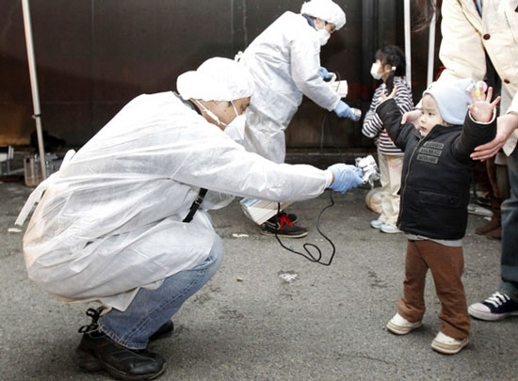
Catastrophic accidents
The economic costs of the Chernobyl and Fukushima disasters were ~A$1 trillion each. In Australia, that equates to $40,000 for every single citizen.
A total of half a million people were evacuated after the Chernobyl (350,000) and Fukushima (160,000) disasters.
Chernobyl is expected to result in about 16,000 cases of thyroid cancer and 25,000 cases of other cancers by 2065 according to a study published in the International Journal of Cancer, including 16,000 fatal cancers.
Radioactive exposure from Fukushima will cause an estimated 5,000 fatal cancers, in addition to the indirect death toll of at least 2,000 people resulting from the botched evacuation and mistreatment of evacuees.

Slide 16
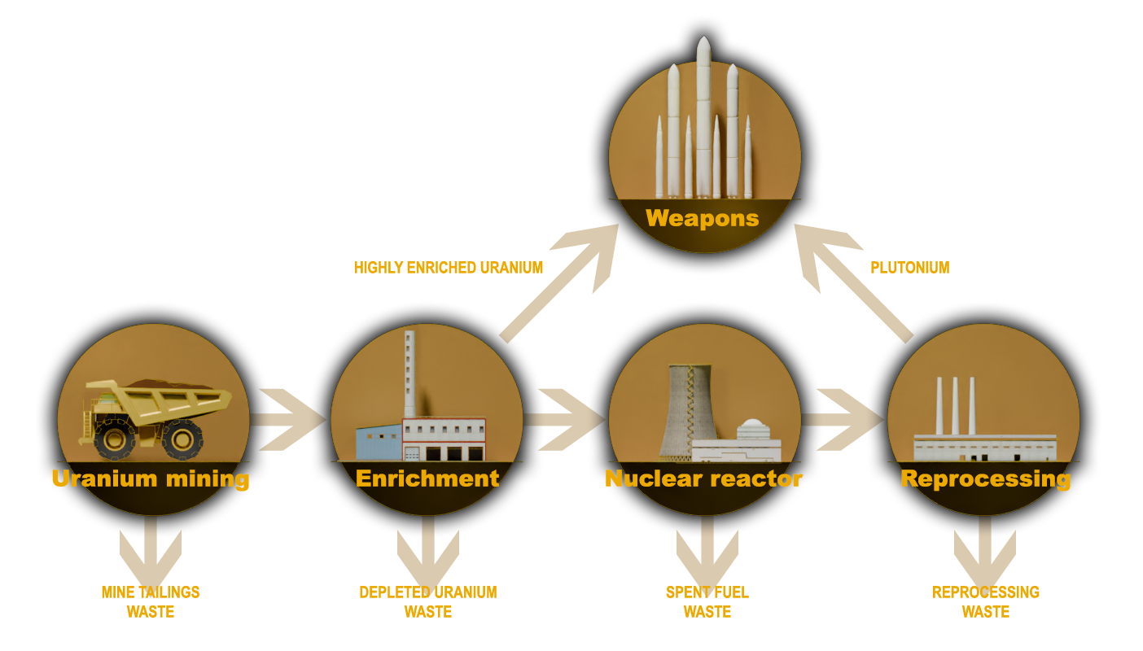
Nuclear power and weapons proliferation
Five of the 10 countries that produced nuclear weapons did so under cover of a ‘peaceful’ nuclear program.
Australia pursued nuclear power as a stepping stone to nuclear weapons.
After decades of deceit and denial, the nuclear power industry now openly acknowledges its contribution to weapons proliferation … and wants greater subsidies so it can continue to support weapons programs.
Former US Vice President Al Gore: “For eight years in the White House, every weapons-proliferation problem we dealt with was connected to a civilian reactor program. And if we ever got to the point where we wanted to use nuclear reactors to back out a lot of coal ... then we'd have to put them in so many places we'd run that proliferation risk right off the reasonability scale.”
More info: nuclear.foe.org.au/power-weapons

Slide 17
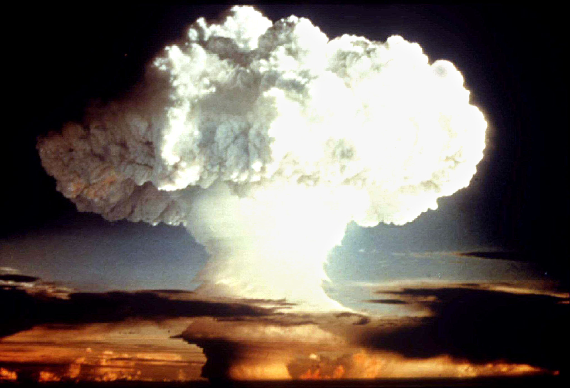
Nuclear warfare and climate change
Nuclear warfare has the potential to cause catastrophic climate change by lifting vast amounts of aerosols, smoke, soot and dust into the atmosphere … this is called ‘nuclear winter’.
Burning fossil fuels is the SUREST route to climate catastrophe.
Nuclear warfare the FASTEST route to climate catastrophe.

Slide 18
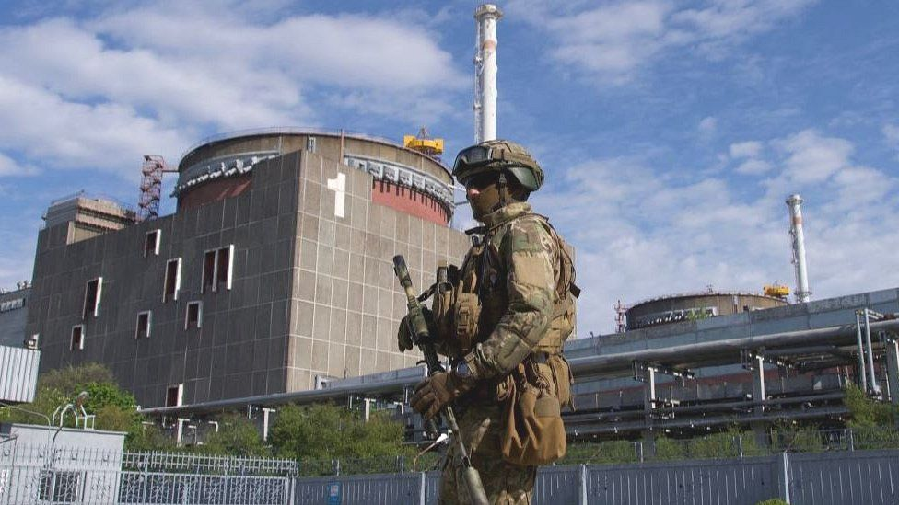
Military attacks on nuclear plants
Some examples:
1981 – Israel destroyed a research reactor in Iraq.
1980-88 – Iran and Iraq targeted each other’s nuclear sites.
1991 – US destroyed a research reactor in Iraq.
2007 - Israel attacked a research reactor in Syria.
2022 - Russia seized nuclear power sites in Ukraine and bombed nuclear facilities.
Worst-case scenario:
Nuclear-powered nations at war are risking multiple simultaneous Chernobyl or Fukushima-scale nuclear disasters in addition to the non-nuclear horrors of war.
Emergency response and evacuation difficult or impossible due to surrounding conflict.

Slide 19
Russia’s invasion of Ukraine
International Atomic Energy Agency (IAEA) 2023 report, ‘Nuclear Safety, Security and Safeguards in Ukraine’
“Every single one of the IAEA’s crucial seven indispensable pillars for ensuring nuclear safety and security in an armed conflict has been compromised, including the physical integrity of nuclear facilities; the operation of safety and security systems; the working conditions of staff; supply chains, communication channels, radiation monitoring and emergency arrangements; and the crucial off-site power supply.”
“Shelling, air attacks, reduced staffing levels, difficult working conditions, frequent losses of off-site power, disruption to the supply chain and the unavailability of spare parts, as well as deviations from planned activities and normal operations, have impacted each nuclear facility and many activities involving radioactive sources in Ukraine.”
Loss of off-site power, and thus reliance on diesel generators to power reactor cooling, increases the risk of nuclear fuel meltdown and significantly increases the risk of a nuclear disaster. The Zaporizhzhia nuclear power plant has lost off-site power 8 times since Russia’s invasion of Ukraine began.

Slide 20
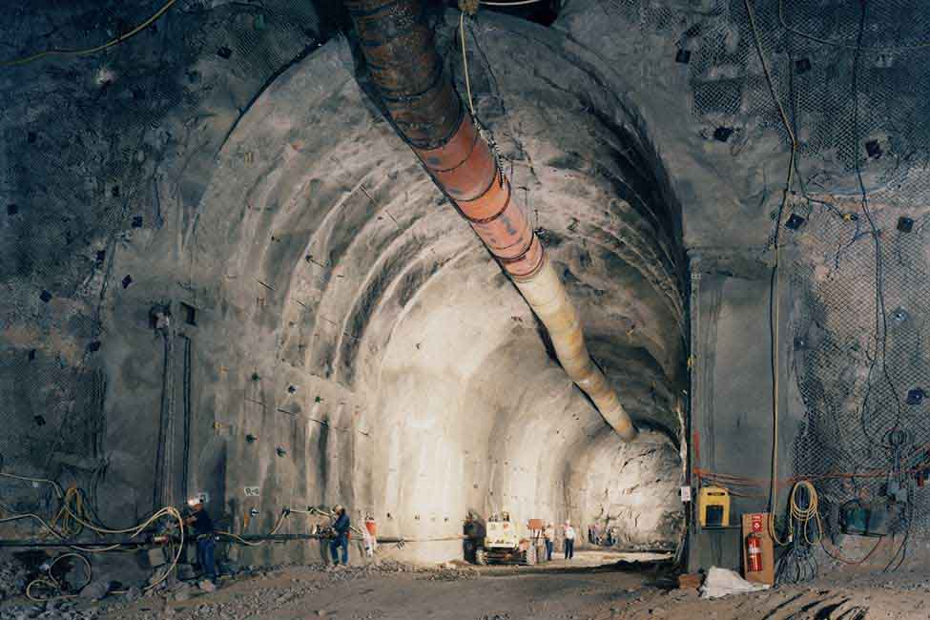
Nuclear waste
No deep underground repositories for high-level nuclear waste are operating anywhere in the world. (Finland and Sweden are building HLW repositories.) Only temporary storage facilities currently exist, with much of the waste stored at nuclear power plants.
One deep underground repository for intermediate-level waste, ‘WIPP’ (Waste Isolation Pilot Plant) in the US. In 2014 an underground explosion in a nuclear waste barrel closed WIPP for 3 years.
A liquid high-level nuclear-waste tank exploded at Mayak, USSR, in 1957. 10,000 people were evacuated, and an area of at least 800 km² was contaminated long-term.
Australia still has many unresolved radioactive waste legacies: Maralinga, Radium Hill, Woomera, Port Pirie, Ranger etc.
There have been many failed attempts to establish permanent stores/dumps for Australia’s existing radioactive waste (mainly from ANSTO’s Lucas Heights nuclear research reactor).
More info: nuclear.foe.org.au/waste

Slide 21
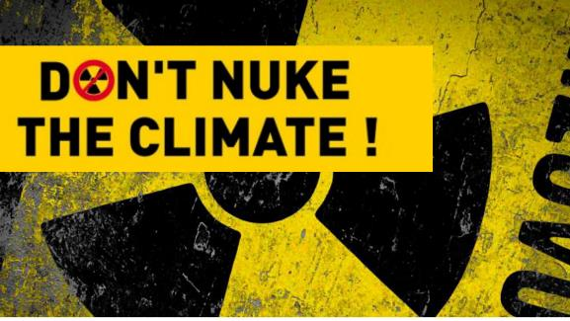
Take action
Visit the Don’t Nuke the Climate website for upcoming actions, petitions and other campaign initiatives:
dont-nuke-the-climate.org.au/takeaction
Please support the Don’t Nuke the Climate socials:
facebook.com/dontnukeaus
x.com/dontnuke
youtube.com/@DontNukeTheClimate
instagram.com/dontnuketheclimateaus/
Visit nonukes.com.au to support the Seven Regions Community Alliance
Download this PowerPoint at nuclear.foe.org.au and use it for presentations in your community
More information
Don’t Nuke the Climate dont-nuke-the-climate.org.au
Australian Conservation Foundation acf.org.au/nuclear-free
Friends of the Earth nuclear.foe.org.au
fact-checking: nuclear.foe.org.au/fact-checking
RenewEconomy reneweconomy.com.au/?s=nuclear (sign up for daily updates)
ETU ‘No Future for Nuclear’ nofuture4nuclear.org/

