Slide 1
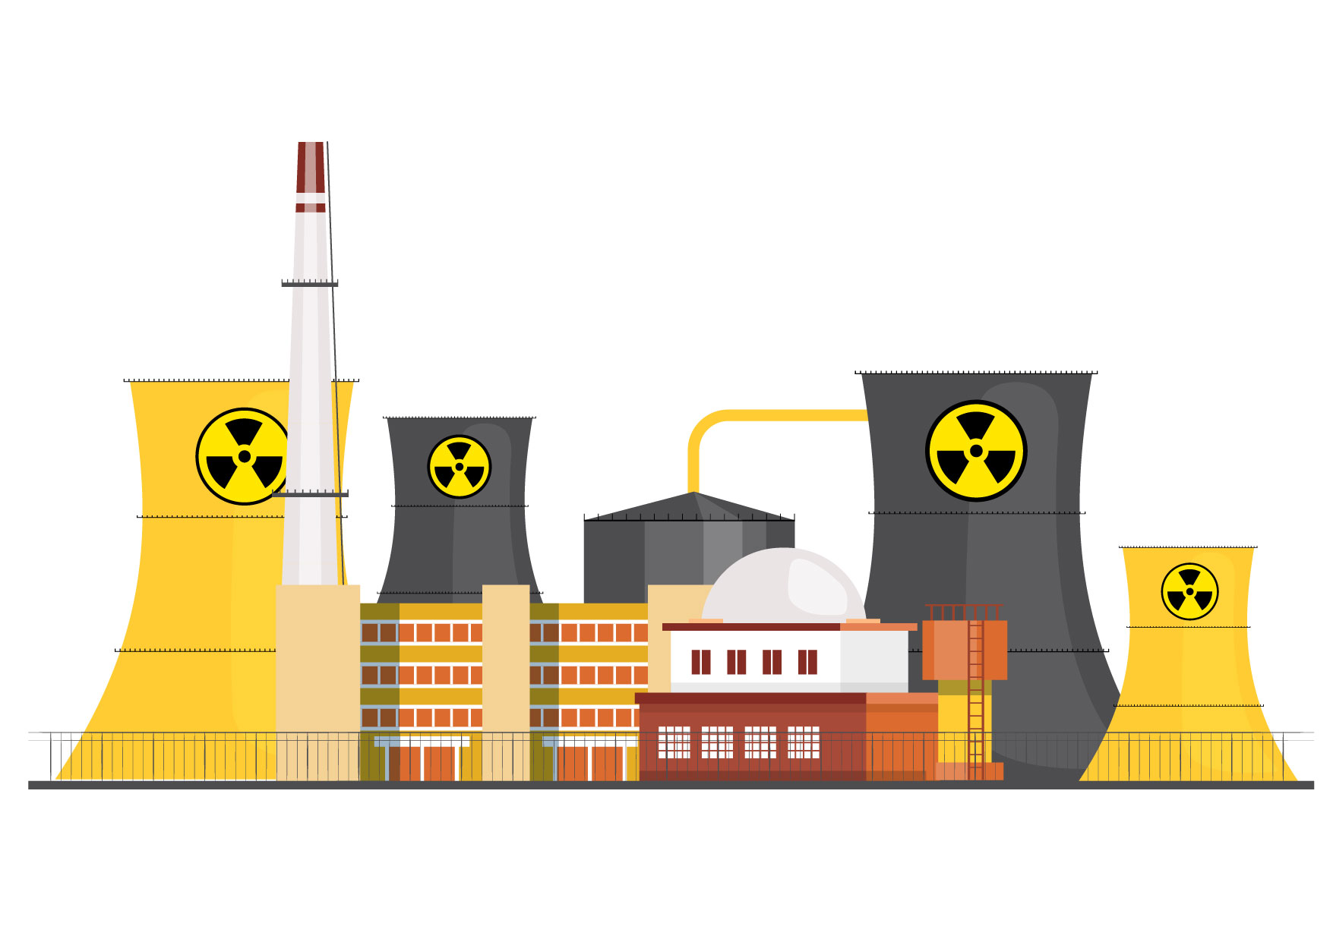
The Dutton Coalition’s Nuclear Power Plan

Slide 2
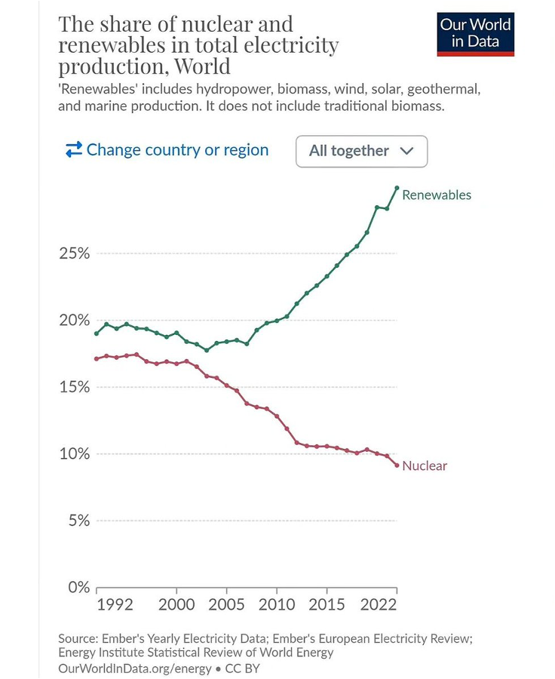
INTERNATIONAL CONTEXT
Nuclear power has fallen from its peak of 17.5% of global electricity generation to just 9.2% now.
Renewables have grown to 30.2% and the International Energy Agency expects renewables to reach 42% by 2028.
Main reasons:
Massive cost reductions for renewables
Massive cost increases for nuclear power
Fukushima

Slide 3
INTERNATIONAL CONTEXT
USA:
Construction of two reactors in South Carolina was abandoned in 2017 after the expenditure of around A$13.6 billion. Westinghouse filed for bankruptcy protection.
The only remaining construction project, two AP1000 reactors in the state of Georgia (known as the Vogtle project), was recently completed at an astronomical cost of approx. A$25.7 billion per reactor.
The Dutton Coalition is promoting AP1000 reactors!
Zero reactors now under construction in the USA.
UK:
The cost of the two EPR reactors under construction at Hinkley Point -- the only reactors under construction in the UK -- has escalated to A$43.5 billion per reactor.
The Golden Rule of Nuclear Economics
Add a zero to industry cost estimates.
The US and UK illustrate the point: in both cases, the latest cost estimates are more than 10 times higher than early estimates.
When the Coalition releases its cost estimates, those estimates will be a small fraction of the real costs of nuclear power

Slide 4
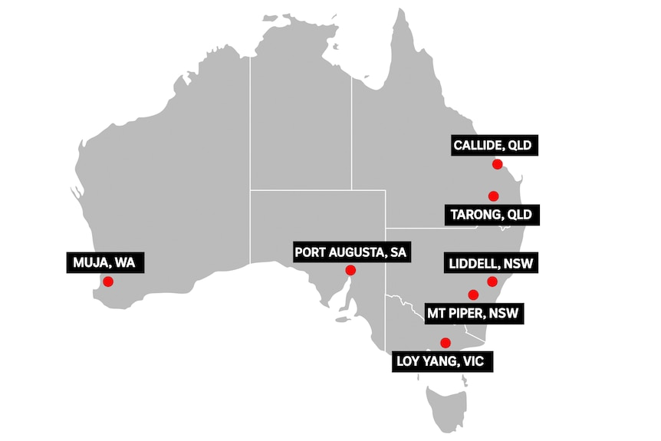
THE COALITION’S NUCLEAR PLAN
Nuclear power reactors at 7 closed or soon-to-be-closed coal power sites.
Non-existent ‘small modular reactors’ in SA and WA. Large reactors in the eastern states.
Government funded.
Unknown number of reactors at each of the 7 sites.
First reactors operating by 2035-37 but in reality they couldn’t begin operating until the mid-2040s.
If realised, the nuclear reactors might produce 5-10% of Australia’s electricity demand by 2050.

Slide 5
SOUTH AUSTRALIA
Mr. Dutton says SA will get one or more nuclear power reactors whether we like it or not and whether or not we need the additional power supply.
SA has gone from 1% renewable electricity supply to 74% over the past 16 years and the government aims to reach 100 percent net renewables by 2027.
SA will reach 100% net renewables long before a nuclear reactor could possibly begin generating electricity 20+ years from now.
The Northern Power Station near Port Augusta, one of the seven sites targeted by the Coalition, was shut down in 2016 and the region has since become a renewables hub.
Using existing electricity transmission infrastructure at old coal plants is Mr. Dutton’s #1 argument in support of his coal-to-nuclear plan, but transmission lines at Port Augusta are being used to transmit renewable power.
SA Premier Peter Malinauskas says: “Every single objective, independent analysis that has looked at this has said nuclear power would make power more expensive in Australia rather than cheaper. Why we would impose that burden on power consumers in our country is completely beyond me.”

Slide 6
COALITION RESPONSE’S TO THE COALITION’S PLAN
Dutton’s nuclear power plan has very little support from Liberal/Coalition leaders in the five states being targeted (and no support from state Labor governments).
Malcolm Turnbull says the nuclear policy is “bonkers”, that Peter Dutton is a “thug” who says “stupid things” about nuclear power, and that nuclear power “is exactly what you don’t need to firm renewables.
Matt Kean, former NSW deputy premier, says: “I not only regard advocacy for nuclear power as against the public interest on environmental, engineering and economic grounds, I also see it as an attempt to delay and defer responsible and decisive action on climate change in a way that seems to drive up power prices in NSW by delaying renewables.”
Former federal Liberal leader John Hewson says the Dutton opposition has become “ridiculous” with its pro-nuclear, anti-renewables stance which is economic “nonsense”, and that Dutton may be promoting nuclear “on behalf of large fossil-fuel donors knowing nuclear power will end up being too expensive and take too long to implement, thereby extending Australia’s reliance on coal and natural gas”.
One Coalition MP says Peter Dutton’s nuclear power policy is “madness on steroids”, another says the Liberal and National Party rooms are “in a panic” about the nuclear policy, and another says the nuclear policy is “bonkers”.

Slide 7
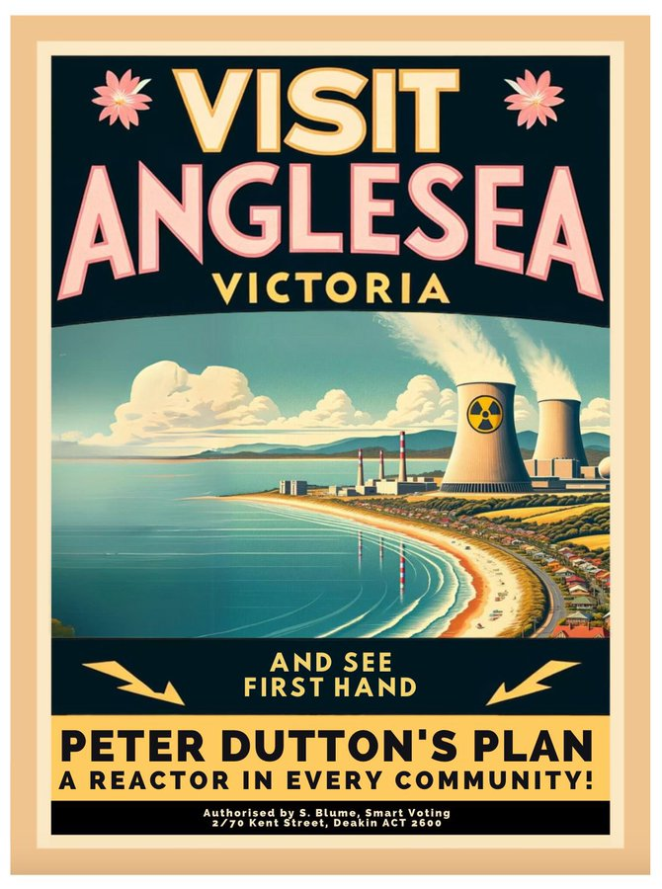
COULD A COALITION GOVERNMENT DELIVER?
Yes, a Coalition government could use taxpayer funds.
Yes, it could override opposition from state governments (including state legal bans).
Yes, it could use compulsory acquisition laws to acquire the coal power sites from the current owners (who are already pursuing renewable energy and storage projects and have no interest in nuclear power).
Yes, it could override opposition from local communities and First Nations.
But it would need to get legislation through the Senate and that might be an obstacle.

Slide 8
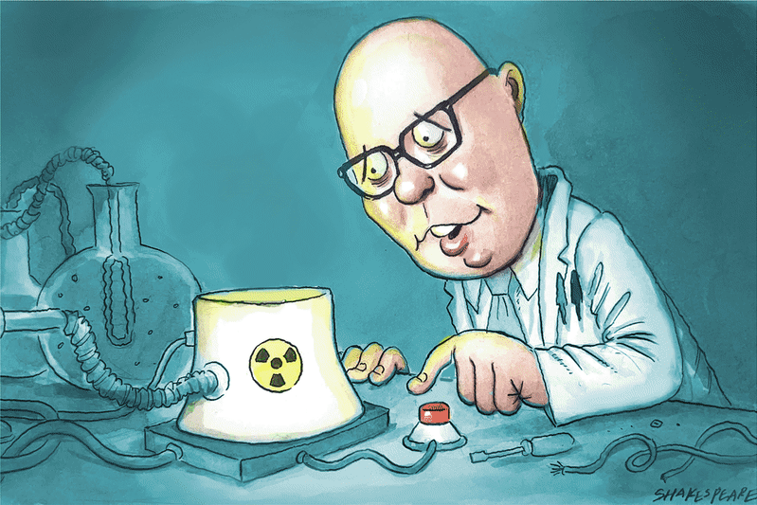
GREENHOUSE EMISSIONS
IF IT WAS A GOOD-FAITH COALITION POLICY TO REDUCE GREENHOUSE EMISSIONS …
Nuclear power would slow the transition to low-carbon power, and make it more expensive and more dangerous.
BUT IT IS NOT A GOOD-FAITH POLICY TO REDUCE GREENHOUSE EMISSIONS
The Dutton Coalition wants to completely derail the transition to low-carbon power and to:
Prolong the life of coal plants and probably build new coal plants. Polluting and expensive.
Massively increase the use of gas power (currently just 4.8% of electricity generation in the National Electricity Market). Polluting and very expensive.
Malcolm Turnbull says the [climate] “science denying” element in the Coalition is “crazy, and to some extent getting crazier”.

Slide 9
DERAILING THE RENEWABLE ENERGY TRANSITION
The Coalition:
Plans to abandon the current government’s target of 82% renewables by 2030
Opposes the current government’s target to cut emissions by 43% by 2030 (the Coalition will not establish 2030 or 2035 targets).
Plans to rip up contracts signed by the Commonwealth in its Capacity Investment Scheme.
The Nationals are calling for a moratorium on the rollout of large-scale renewables and that will probably become formal Coalition policy.
Withdraw Australia’s pledge at the Dec. 2023 COP28 UN climate conference to triple renewable energy and double the rate of energy efficiency by 2030.
Sign Australia up to a COP28 pledge to triple nuclear power by 2050.
Queensland National Party Senator Matt Canavan says the Coalition intends to shut down the Climate Change Authority. The Abbott government defunded the independent Climate Commission but failed in its efforts to kill off the Climate Change Authority and the Australian Renewable Energy Agency.

Slide 10
MASSIVE INCREASE IN GREENHOUSE EMISSIONS
CSIRO: nuclear won’t be able to make a meaningful contribution to achieving net zero emissions by 2050
“Long development times mean nuclear won’t be able to make a meaningful contribution to achieving net zero emissions by 2050.”
Australia will not come close to net zero by 2050 under Coalition’s nuclear plan
George Wilkenfeld and Clive Hamilton: “The Coalition’s nuclear strategy would increase Australia’s cumulative emissions over the period to 2050 by at least 1,462 Mt CO2-e compared with the renewables pathway.
Nuclear reactors a disaster for climate emissions
New analysis by Solutions for Climate Australia has found that pursuing nuclear reactors in Australia would result in an additional 2.3 billion tonnes of climate emissions between now and 2050 when compared to the Australian Energy Market Operator’s Integrated System Plan ‘Step Change Scenario’.
Nuclear could ‘sound the death knell’ for Australia’s decarbonisation efforts, report says
A nuclear-powered Australian economy would result in higher-cost electricity and would “sound the death knell” for decarbonisation efforts if it distracts from renewables investment, a report by Bloomberg New Energy Finance argues.
Australia’s ‘carbon budget’ may blow out by 40% under the Coalition’s nuclear energy plan
July 2, 2024, The Conversation, Sven Teske, University of Technology Sydney
Even if the reactors are built, the negative impact on Australia’s carbon emissions would be huge. Over the next decade, the renewables transition would stall and coal and gas emissions would rise – possibly leading to a 40% blowout in Australia’s carbon budget.

Slide 11
WHAT DO SCIENTISTS SAY?
Australia's Chief Scientist Cathy Foley says nuclear power is “expensive” and “it would take some time to build up the capability” to introduce it.
Former Australian Chief Scientist Alan Finkel says that nuclear power is “too slow and too expensive” for Australia.
Another former Australian Chief Scientist, Robin Batterham, says that: “To reduce renewable targets in the belief that nuclear will be deployed later at scale would create a material risk of not achieving net zero, or doing so at an excessive cost.”
NSW Chief Scientist Hugh Durrant-Whyte says that it would be "naive" to think a nuclear power plant could be built in Australia in less than two decades.
Australia’s leading scientific organisation CSIRO says that nuclear power “does not provide an economically competitive solution in Australia” and could not be deployed “within the timeframe required.”
The Climate Council ‒ including many of Australia's leading climate scientists ‒ states that nuclear power plants "are not appropriate for Australia – and never will be", that nuclear power is “expensive, illegal, dangerous and decades away”, and that “we do not need distractions like nuclear to derail our progress” towards a renewable-powered future.

Slide 12
TOO SLOW
Introducing nuclear power to Australia would necessitate:
At least 10 years for: licensing, vendor selection, site selection, regulation, Commonwealth/state negotiations, workforce recruitment and training; an environmental impact assessment process; legislative reform, etc.
Around 10 years for construction; and
An estimated 6.5 years of reactor operation to repay the energy and carbon debts from construction.
So nuclear power couldn’t contribute to greenhouse emissions reductions until ~2050.
Overseas examples
USA Vogtle project: 18 years for planning and construction.
France: 17+ years just for construction.
UK: 20-25+ years for planning and construction.
Finland: 17 years just for construction.
The Coalition’s claim that reactors could be operating by the mid-2030s is nonsense.
Former Australian Chief Scientist Dr. Alan Finkel: “Any call to go directly from coal to nuclear is effectively a call to delay decarbonisation of our electricity system by 20 years.”

Slide 13
TOO EXPENSIVE
ACF ‘Power Games’ report:
Comparing costs of large reactors in the UK and US, and SMR cost estimates, with CSIRO estimates for firmed renewables, nuclear costs (large or small) would need to come down by two-thirds to be competitive with firmed renewables.
Replacing Australia’s 21.3 gigawatts of coal plants with nuclear, large or small, would cost $500 billion to $650 billion (and much more to train a nuclear workforce etc. etc.)
Levelised cost of electricity review
A report prepared for the Clean Energy Council by Egis, a leading global consulting, construction and engineering firm. May 2024.
Nuclear power is up to six times more expensive than renewable energy.
Nuclear is unviable because of economics, not engineering
Even if all that mattered was the cheapest possible energy that meets minimum levels of reliability and emissions, the Coalition's plan fails.
June 23, 2024, Australian Financial Review, Steven Hamilton and Luke Heeney
Power bills could rise by $1,000 a year under Coalition plan
Australians’ annual household power bills could increase by hundreds of dollars, and up to $1,000, under a Coalition plan to slow the rollout of large-scale renewable energy and use more gas-fired electricity before nuclear plants are ready, analysts say.

Slide 14
TOO EXPENSIVE
Coalition’s taxpayer-funded nuclear con a road to ruin
Tim Buckley and Annemarie Jonson, 25 June 2024, Australian Financial Review
It beggars belief that the alternative government proposes nationalising an uncosted nuclear debt bomb and detonating it at the heart of domestic energy and climate policy.
We estimate that the fiscal damage would be in the order of a minimum $100 billion, but likely considerably more given the international experience.
Dutton’s nuclear plan could cost up to $600 billion
Using data from the CSIRO’s latest GenCost report and the Australian Energy Market Operator’s Integrated System Plan, the Smart Energy Council estimates the cost to taxpayers of building 7 reactors to be at least $116 billion. Cost overruns could mean a $600 billion bill to Australian taxpayers.
CSIRO GenCost report, May 2024
 | 2023 ($/MWh) | 2030 ($/MWh)
Large-scale nuclear | 155-252 | 141-233
Small modular reactors | 387-641 | 230-382
90% wind and solar PV supply to the National Electricity Market including storage and transmission costs | 100-143 | 89-128

Slide 15
SMALL MODULAR REACTORS (SMRs)
< 300 MW
Serial factor production of reactor components.
SMRs in China and Russia
Both countries have one twin-reactor SMR
But no modular construction techniques
Couldn’t even be called prototype SMRs since there are no plans to mass-produce more.
SMRs don’t exist.
Many failed SMR projects, e.g. NuScale in the US abandoned its first project in Idaho after costs rose to an exorbitant A$14.0 billion for a 462 MW plant.
More info: nuclear.foe.org.au/smr/

Slide 16
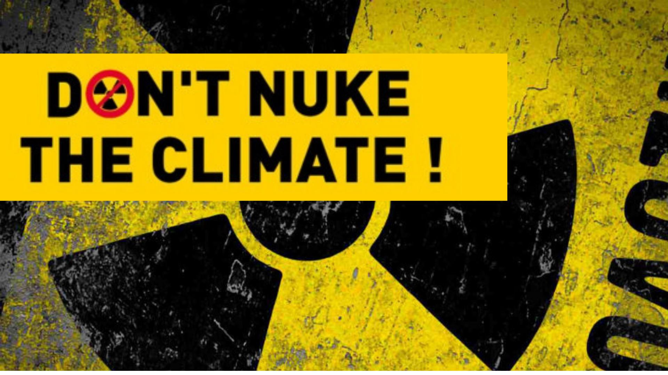
TOO RISKY
Weapons proliferation
Attacks on nuclear plants
Accidents

Slide 17
Nuclear Power and Nuclear Weapons
Five of the ten countries that produced nuclear weapons did so under cover of a ‘peaceful’ nuclear program.
Australia pursued nuclear power as a stepping stone to nuclear weapons.
After decades of deceit and denial, the nuclear power industry now openly acknowledges its contribution to weapons proliferation.
nuclear.foe.org.au/power-weapons
Former US Vice President Al Gore:
“For eight years in the White House, every weapons-proliferation problem we dealt with was connected to a civilian reactor program. And if we ever got to the point where we wanted to use nuclear reactors to back out a lot of coal ... then we'd have to put them in so many places we'd run that proliferation risk right off the reasonability scale.”

Slide 18
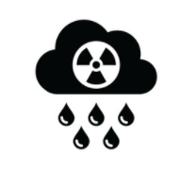
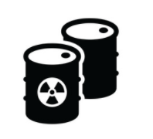
Nuclear Warfare and Climate Change
There are strong connections between nuclear power and nuclear weapons proliferation.
Nuclear warfare has the potential to cause catastrophic climate change by lifting vast amounts of aerosols, smoke, soot and dust into the atmosphere … this is called ‘nuclear winter’.
Alan Robock in The Bulletin of the Atomic Scientists:
"We now understand that the atmospheric effects of a nuclear war would last for at least a decade − more than proving the nuclear winter theory of the 1980s correct. By our calculations, a regional nuclear war using less than 0.3% of the current global arsenal would produce climate change unprecedented in recorded human history.”
Fossil fuel burning in the surest route to climate catastrophe.
Nuclear warfare is the fastest route to climate catastrophe.

Slide 19
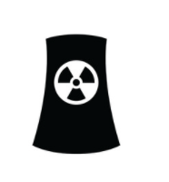
Military Attacks on Nuclear Plants
1981 – Israel destroyed a research reactor in Iraq
1980-88 – Iran and Iraq targeted each others nuclear sites
1991 – US destroyed a research reactor in Iraq
2007 - Israel attacked a research reactor in Syria
2022 - Russia seized nuclear power sites in Ukraine and bombed nuclear facilities.
Worst-case scenario:
Two (or more) nuclear-powered nations at war … risk of multiple simultaneous Chernobyl or Fukushima-scale nuclear disasters.
Emergency response and evacuation difficult or impossible due to surrounding conflict.

Slide 20
Military Attacks on Nuclear Plants - Ukraine
IAEA Feb. 2023 report, Nuclear Safety, Security and Safeguards in Ukraine
“Every single one of the IAEA’s crucial seven indispensable pillars for ensuring nuclear safety and security in an armed conflict has been compromised, including the physical integrity of nuclear facilities; the operation of safety and security systems; the working conditions of staff; supply chains, communication channels, radiation monitoring and emergency arrangements; and the crucial off-site power supply.”
Loss of off-site power, and thus reliance on diesel generators to power reactor cooling, sharply increases the risk of nuclear fuel meltdown and significantly increases the risk of a nuclear disaster. The Zaporizhzhia nuclear power plant has lost off-site power 8 times since Russia’s invasion began.
The IAEA report further states:
“Shelling, air attacks, reduced staffing levels, difficult working conditions, frequent losses of off-site power, disruption to the supply chain and the unavailability of spare parts, as well as deviations from planned activities and normal operations, have impacted each nuclear facility and many activities involving radioactive sources in Ukraine.

Slide 21
Nuclear Disasters
The economic costs of the Chernobyl and Fukushima disasters amounted to around A$1 trillion each. In Australia, that would equate to $40,000 for every single citizen.
Over half a million people were evacuated after the Chernobyl (350,000) and Fukushima (160,000) disasters.
The lowest scientific estimate of the Chernobyl cancer death toll across Europe is the estimate of 16,000 deaths in a study published in the International Journal of Cancer.
Radioactive fallout from Fukushima will cause an estimated 5,000 fatal cancers, in addition to the indirect death toll of at least 2,000 people resulting from the botched evacuation and mistreatment of evacuees.

Slide 22
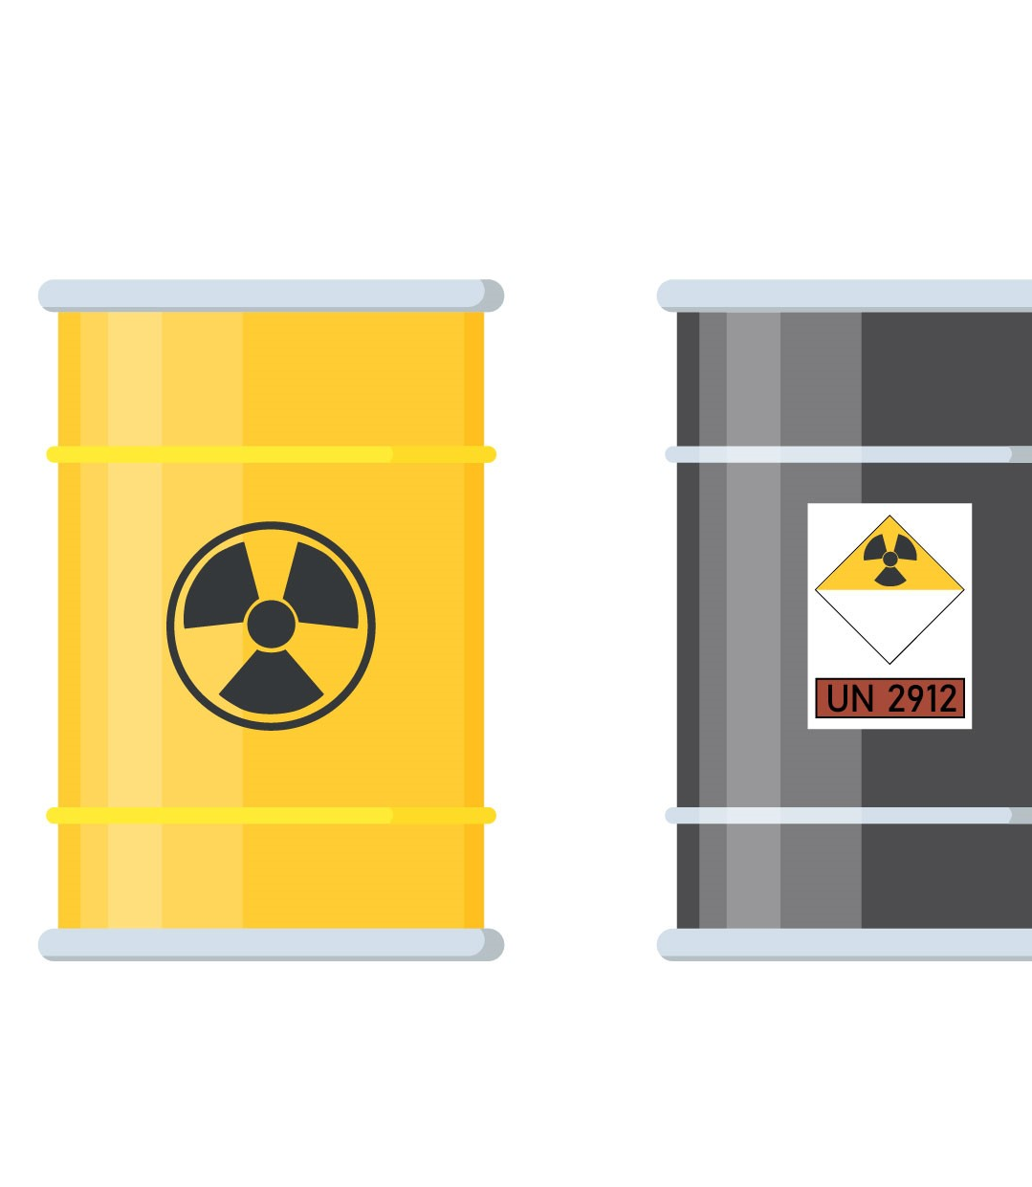
Nuclear Waste
Zero deep underground repositories for high-level nuclear waste from nuclear power reactors.
One deep underground repository for intermediate-level waste, ‘WIPP’ in the US state of New Mexico. 2014 underground explosion in a nuclear waste barrel closed WIPP for three years.
Explosion of a liquid high-level nuclear waste tank at Mayak in Soviet Union in 1957 was one of the world's worst nuclear accidents, 10,000 people evacuated, long-term contamination of more than 800 sq kms.
Unresolved nuclear waste legacies in Australia: Maralinga, Radium Hill, Woomera, Port Pirie, etc.
Looming efforts to establish nuclear stores/dumps for Australia’s existing waste (mainly from Lucas Heights) and AUKUS waste.

Slide 23
Fact-checking resources
1. Myth-busting info at dont-nuke-the-climate.org.au
2. The Coalition says its nuclear plants will run for 100 years. What does the international experience tell us?
The average age of an active nuclear reactor worldwide is about 32 years – and a live plant reaching even 60 years has ‘never happened’.
3. Cheaper electricity, less emissions and ready by 2035 are some of the Coalition’s core promises on nuclear energy, but are they backed by evidence?
Would nuclear power provide cheaper electricity?
Will using more gas until nuclear comes online cut costs?
Will the Coalition’s plan be ‘cleaner’, as it claims?
Could Australia have nuclear energy by 2035?
Have renewables caused a big increase in power bills?
Is it true that “Labor can’t keep the lights on today”?
Is it true that you can’t run an industrial economy on renewables?

Slide 24
Fact-checking resources
4. The Coalition says the rest of the G20 is powering ahead with nuclear – it’s just not true
5. Dutton’s claim about G20 nuclear energy use doesn’t add up
6. Divide and squander: Dutton wants seven nuclear power plants, the first by 2035
7. Nuclear debate is getting heated, but whose energy plan stacks up?
Labor’s ‘renewables-only’ plan will cost more than $1 trillion: False.
Nuclear energy will deliver cheaper power bills: False.
The renewables rollout needs 28,000 kilometres of transmission lines: False.
The first reactor would be built before 2037: Questionable.
The annual waste from a reactor fits into a Coke can: False.
8. Without a massive grid upgrade, the Coalition’s nuclear plan faces a high-voltage hurdle

Slide 25
More information
Don’t Nuke the Climate
dont-nuke-the-climate.org.au (including useful ‘myth busting’ info)
facebook.com/dontnukeaus
x.com/dontnuke
ACF ‘Power Games’ report
Assessing coal-to-nuclear proposals in Australia
Friends of the Earth
nuclear.foe.org.au
Australian Conservation Foundation
acf.org.au/nuclear-free
RenewEconomy
reneweconomy.com.au/?s=nuclear (and sign up for daily updates)
ETU ‘No Future for Nuclear’
https://nofuture4nuclear.org/

Slide 26
Download this PowerPoint at
nuclear.foe.org.au

